Slide 1
New York
Distracted Driving Summit
Valhalla, New York
Lucia Sanchez
Office of Communications, Digital Strategies Team
National Highway Traffic Safety Administration
May 6, 2014
Notes:
Where there is no policy or program in place, there should also be no communications effort. Therefore, research and data should exist that relates to a program needing promotion.

Slide 2
Proven method

Slide 3
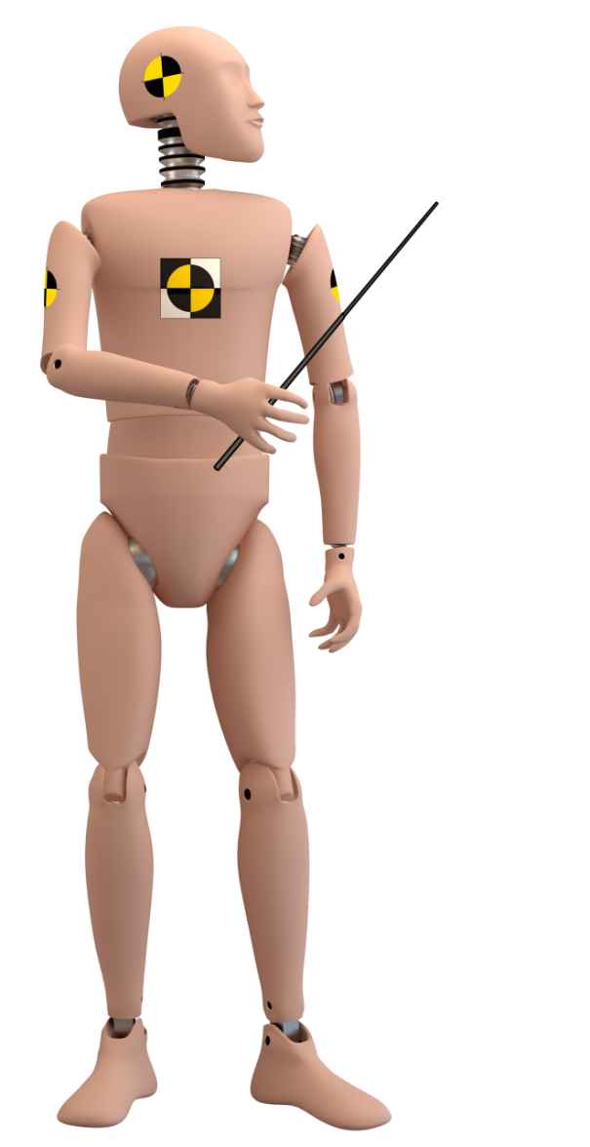

U Drive. U Text. U Pay.

Slide 4
If you’re texting, you’re not driving.
April Distracted Driving Awareness month
Social norming outside of brief enforcement period
“If you’re texting you’re not driving.”

Slide 5
Who are talking to?
Primary: Adults (men and women) 18 to 34
Slight skew toward women
Campaign national in scope with no regional emphasis
Spanish language included

Slide 6
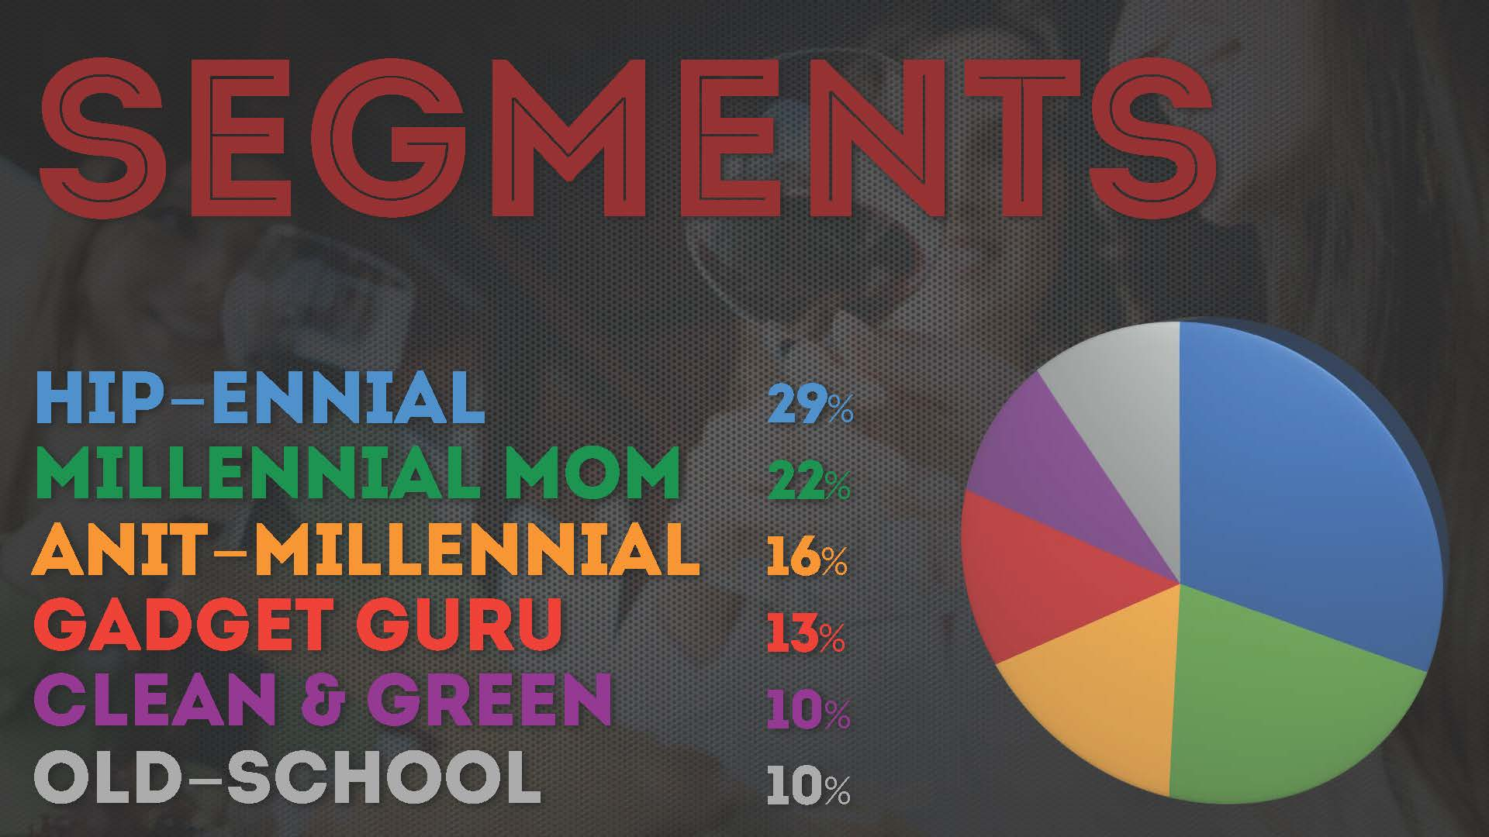
GEN-Y – AGES 16 – 34 – 80 MILLION Strong

Slide 7

Largest segment
Notes:
The hip-ennial is cautious consumer, globally aware, charitable, and hungry for information.
This person is a great user of social media but does not push/contribute content.
The segment is female-dominated with below-average employment as many is the group are students & homemakers
You can find the hip-ennial on channels like YouTube, Vine, Twitter, and SnapChat

Slide 8
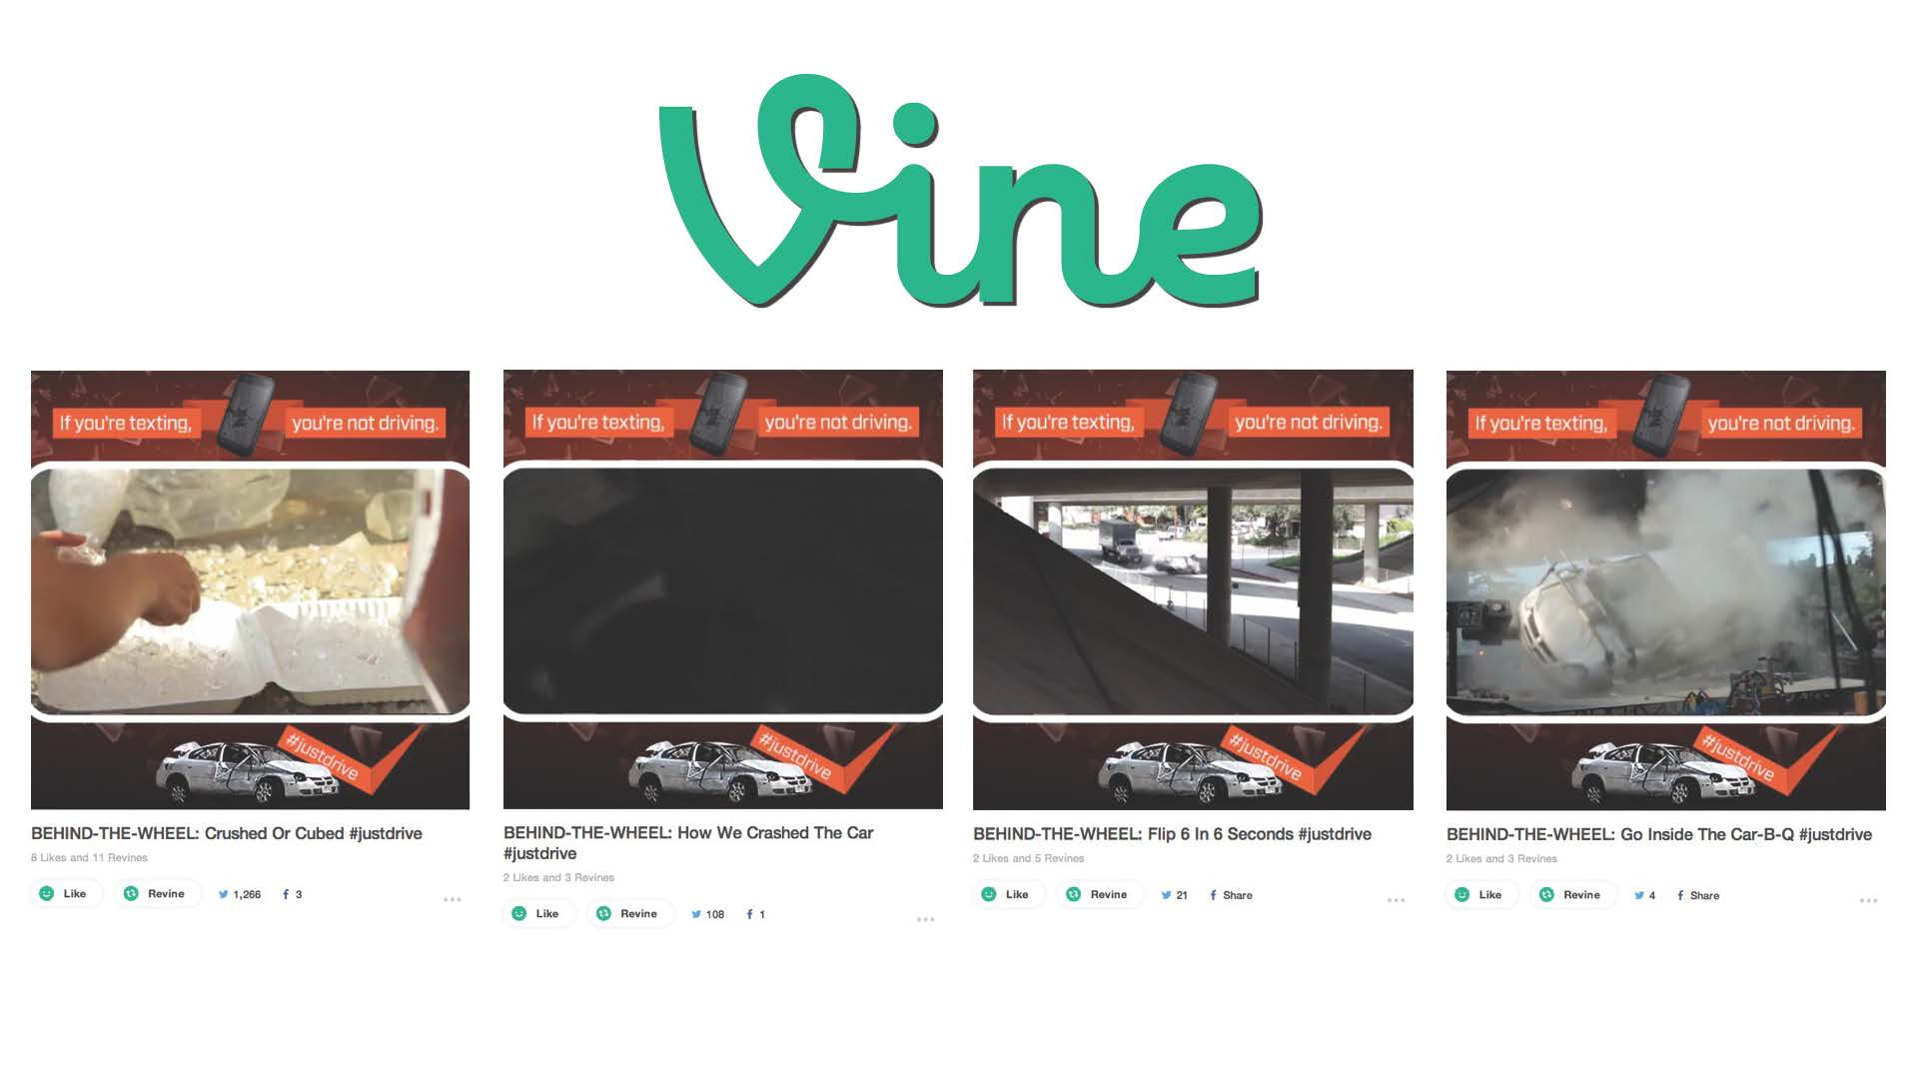
Tactic: Vine videos

Slide 9
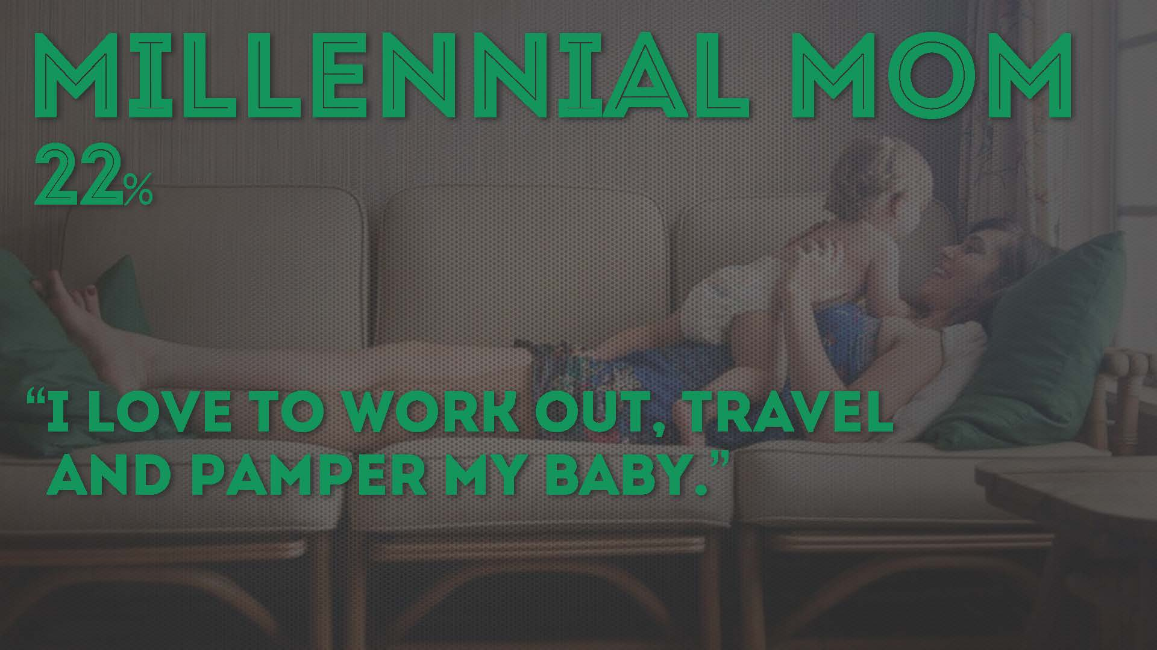
2nd largest segment
Notes:
The Millenial Mom is wealthy, family oriented, works out, confident, and digitally savvy
She has a high online intensity, is highly social hungry for information. She can at times feel isolated from others by daily routine, she is in the older end of the age range and at the highest income range for this group.

Slide 10
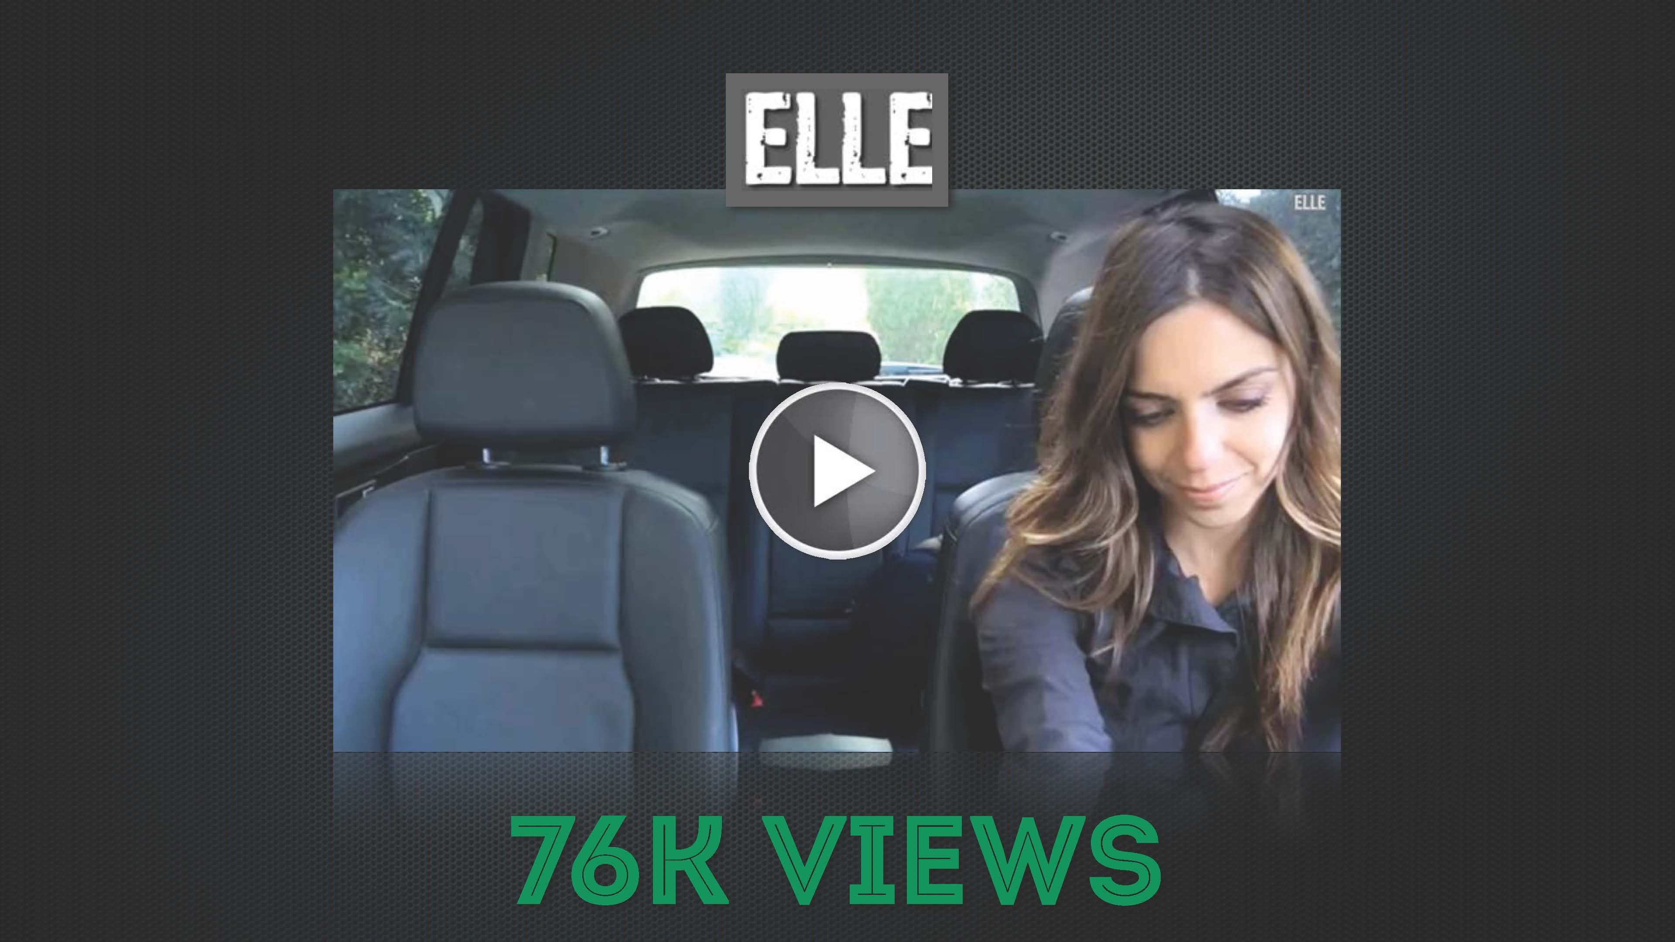
Tactic: YouTube Star

Slide 11
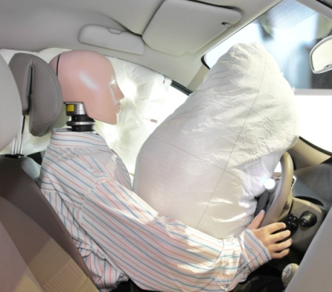

3rd Largest Segment
Notes:
• locally minded, conservative
• does not spend more for green products and
services
• seeks comfort & familiarity over excitement,
change, interruption
• slightly more female, more likely to be hispanic,
from western u.s.

Slide 12
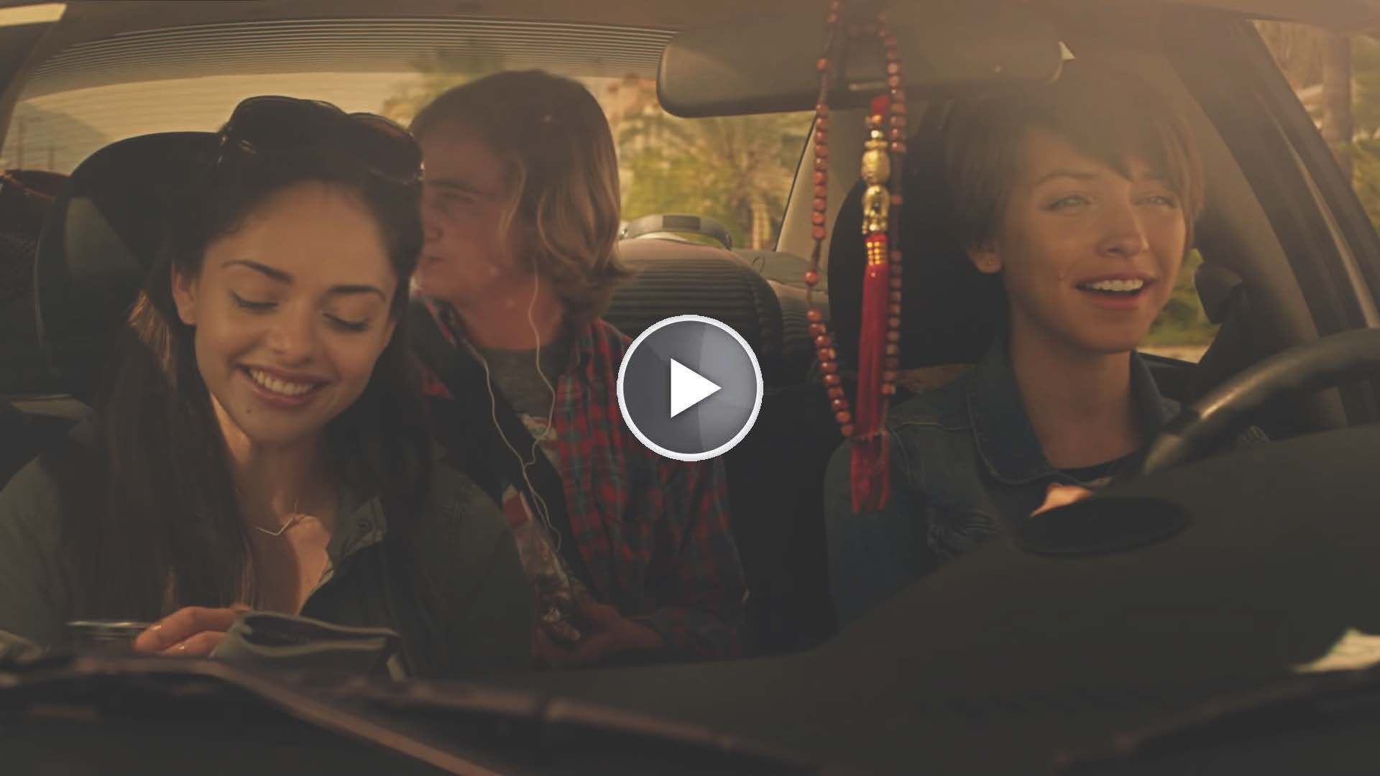
Tactic: Broadcast Ad

Slide 13

4th largest Segment

Slide 14
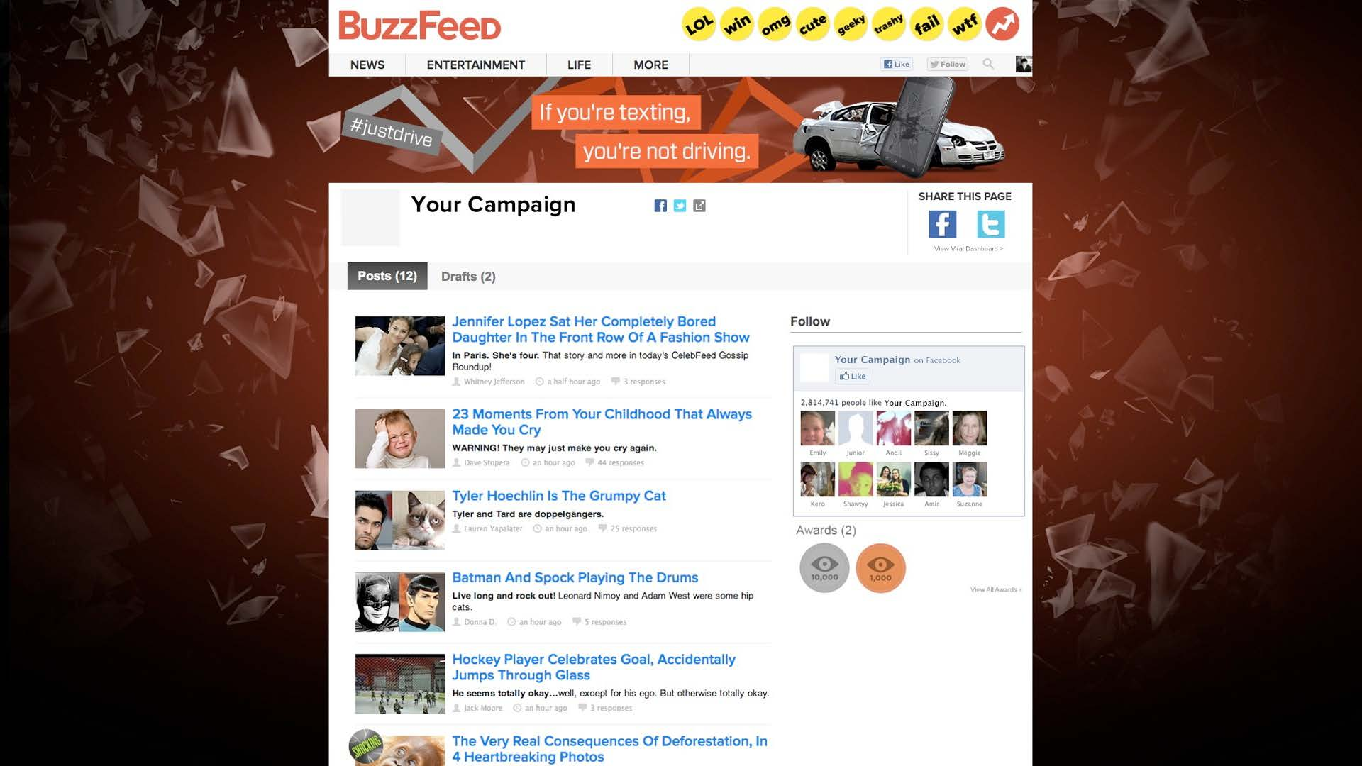
Tactic: Buzzfeed

Slide 15
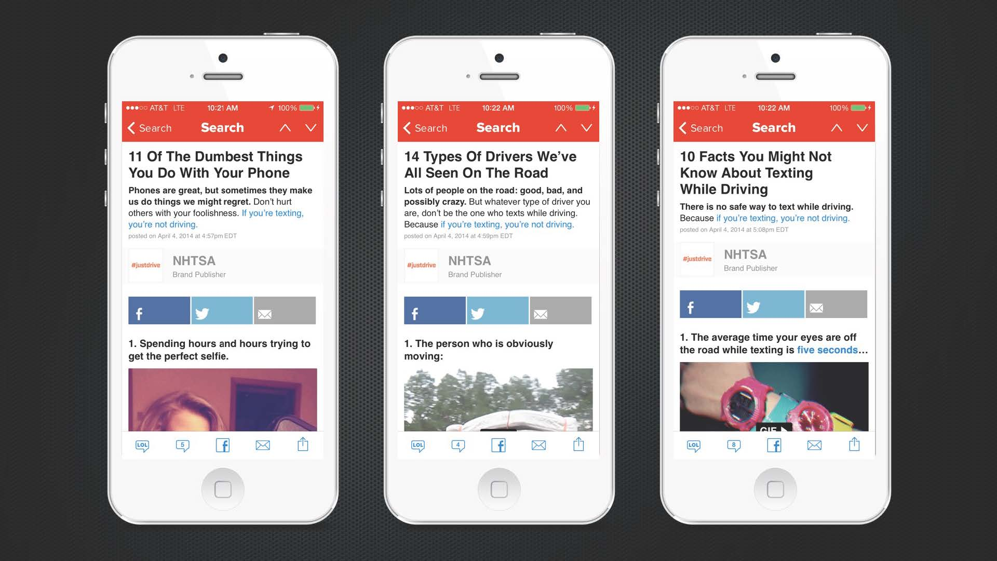
Tactic: Buzzfeed

Slide 16
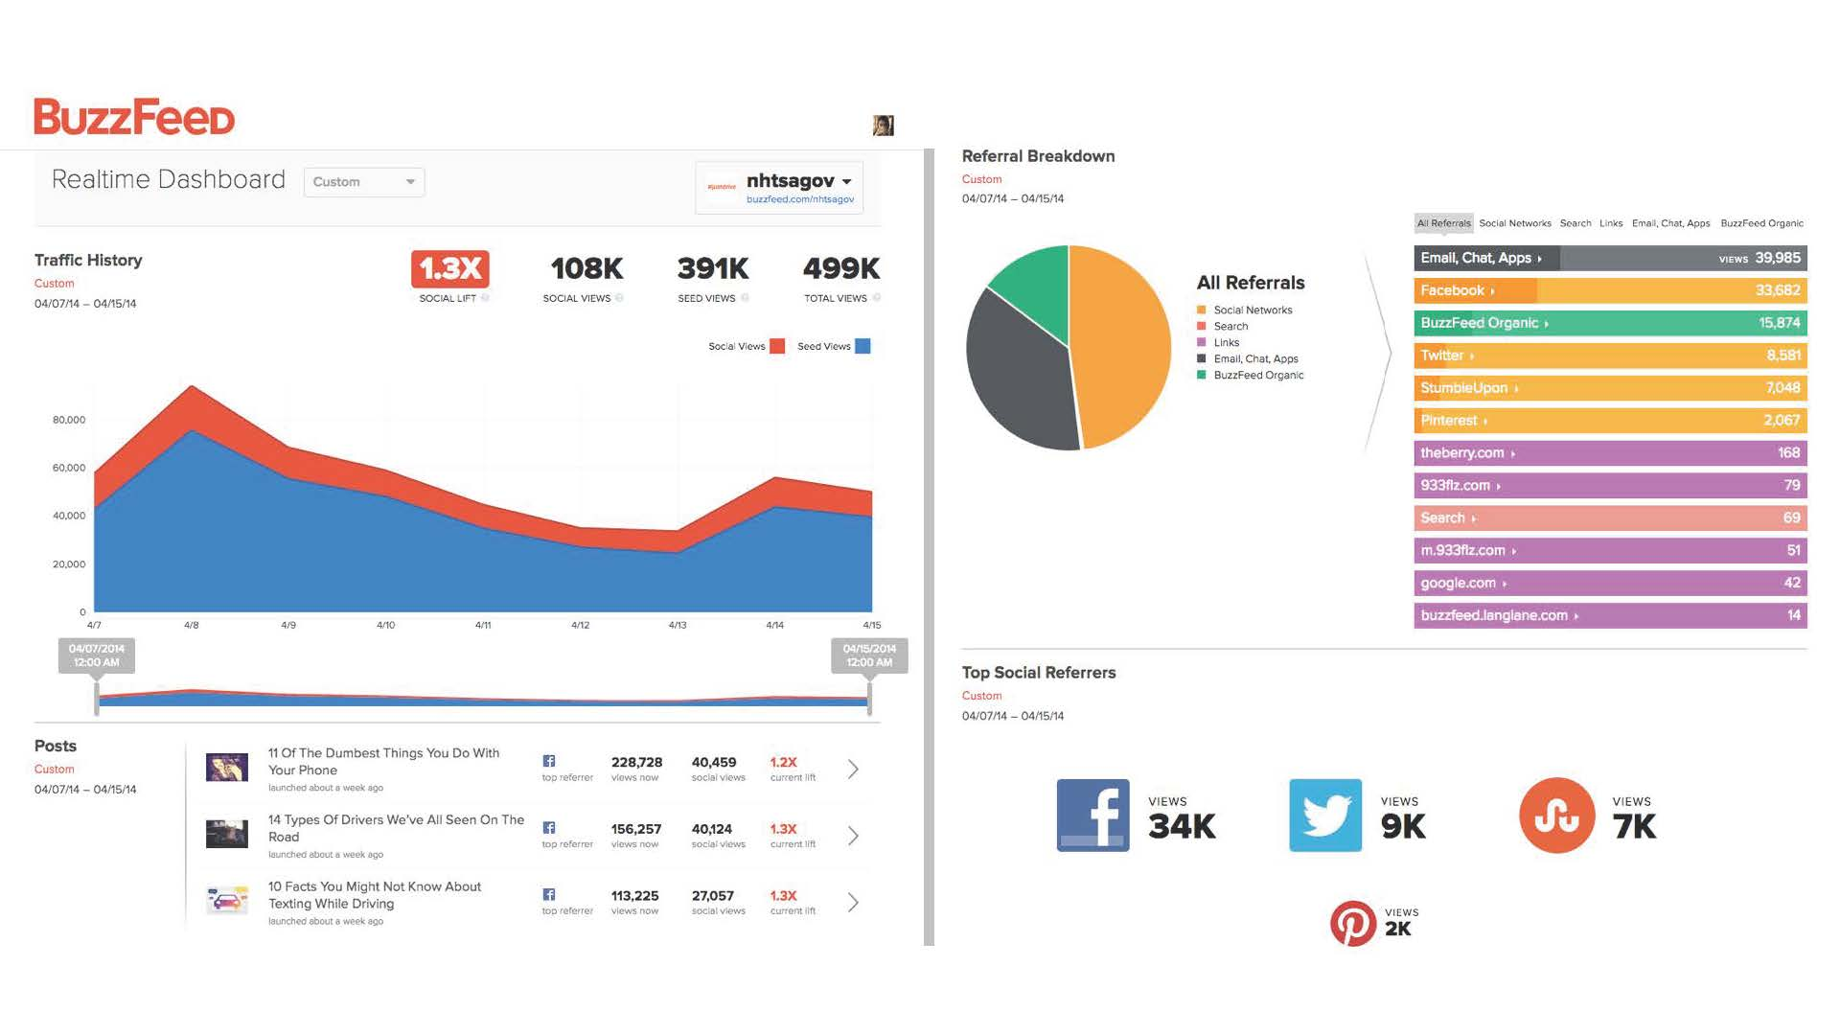
Engagement -- High

Slide 17
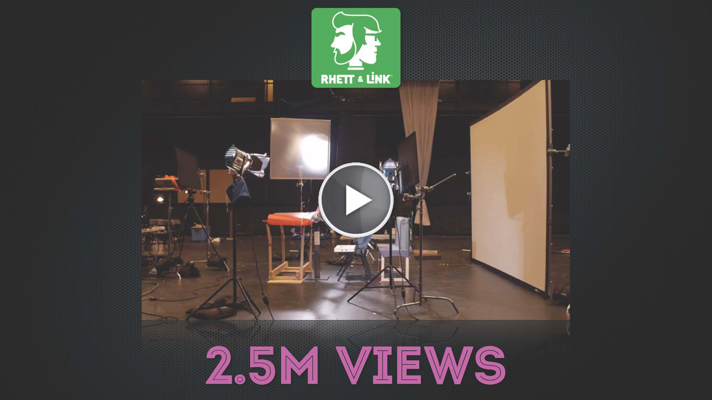
Tactic: YouTube Star

Slide 18

Segement, contd.

Slide 19
Tactic: Online social norming spot

Slide 20
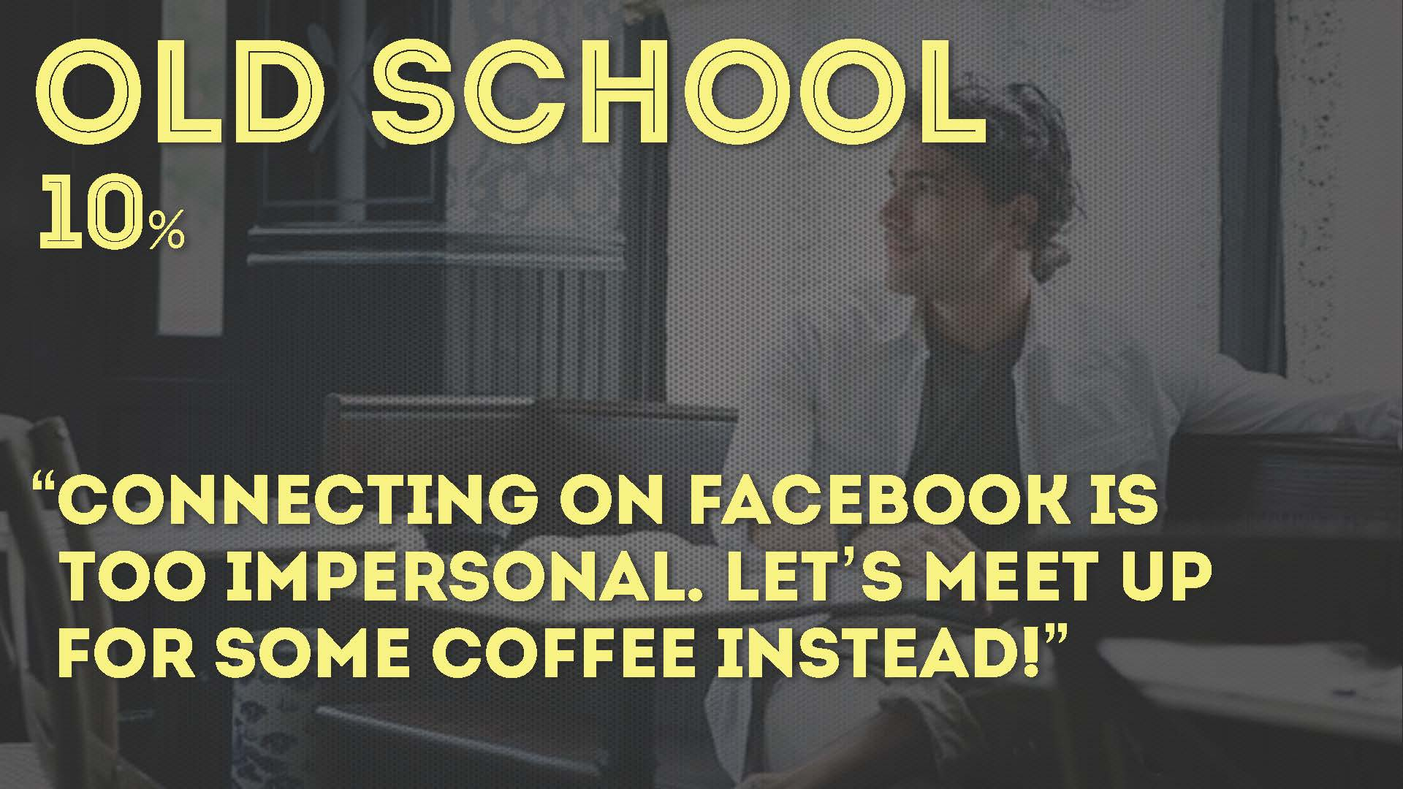
Segment, contd.

Slide 21

Tactic: Surround Sound

Slide 22
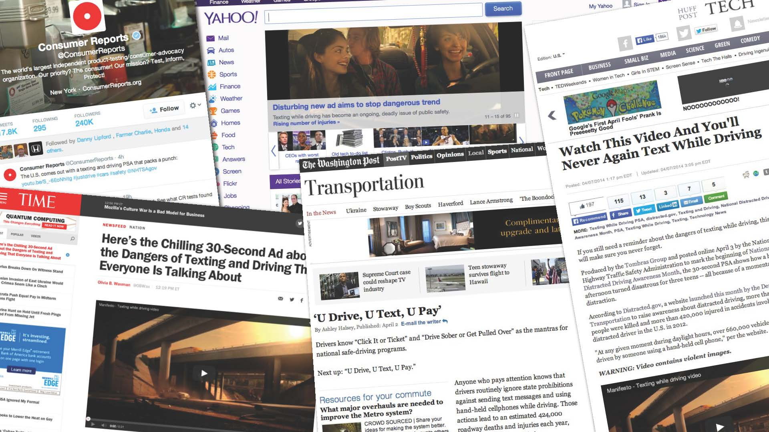
Tactic: Surround Sound

Slide 23
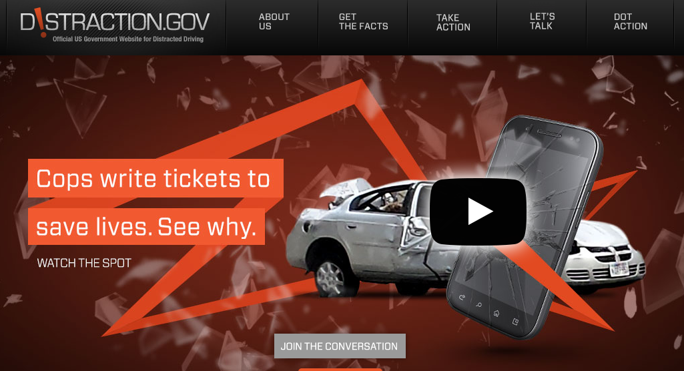
Distraction.gov

Slide 24
Distraction.gov
Campaign tools
Statistics and facts
State laws
Research
Media resources
Material for parents/educators
“Faces of Distraction”

Slide 25
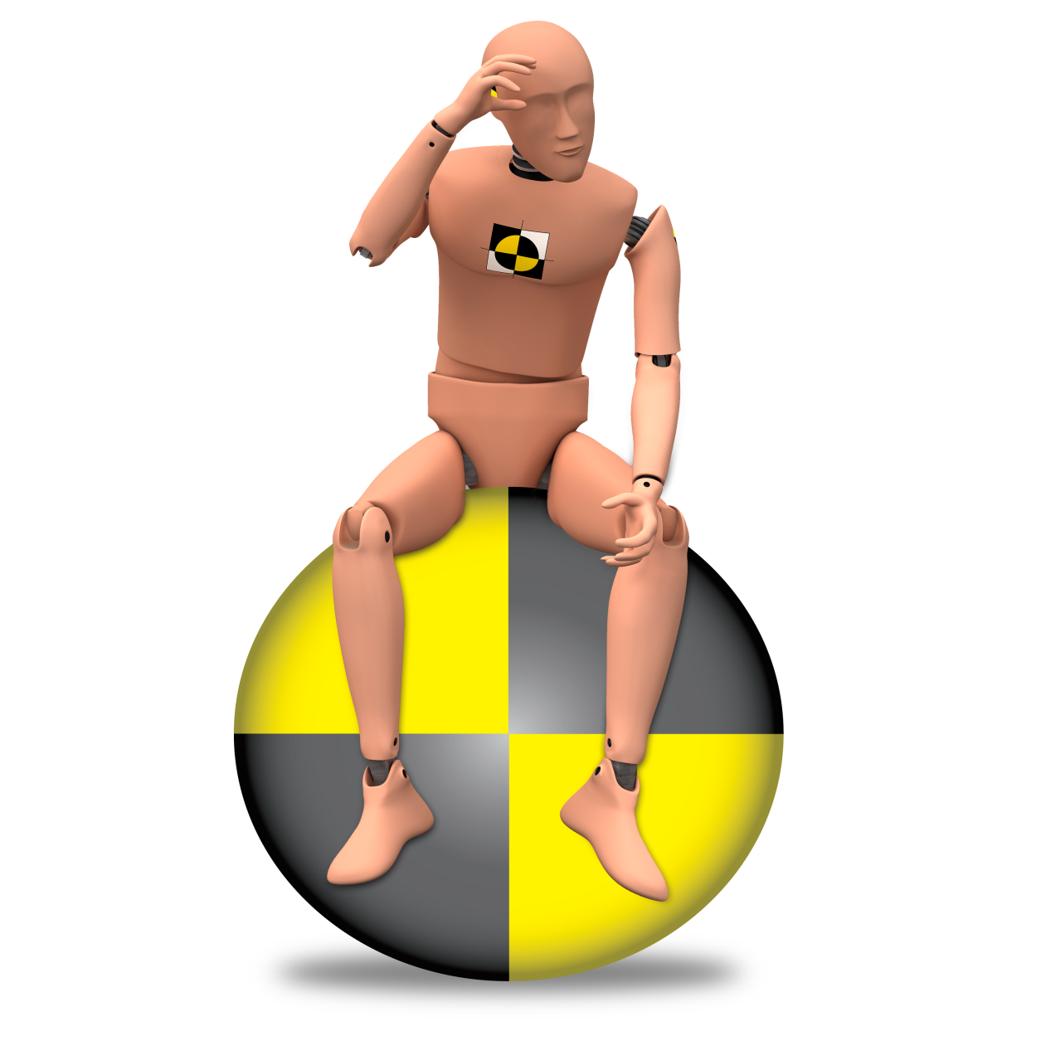




Questions?
9584-041113-v5

