Slide 1
COMMUNICATION,
UNCONSCIOUSNESS,
AND DRIVING
JOSEPH B. BAYER
Ph.D. CANDIDATE
NYDD
2014
Notes:
MY NAME IS JOE BAYER AND I AM CURRENTLY A PHD CANDIDATE AT THE UNIVERSITY OF MICHIGAN
I WANT TO ESPECIALLY THANK JENNIFER SMITH FOR INVITING ME TO SPEAK TODAY
AS WELL ORGANIZING THIS VALUABLE EVENT TO CHANGE THE CONVERSATION ON DISTRACTED DRIVING

Slide 2
COMMUNICATION
Notes:
NOW I COME FROM THE FIELD OF COMMUNICATIONS
AND THIS PROVIDES ME WITH A SOMEWHAT DIFFERENT PERSPECTIVE
ON THE ISSUE OF DISTRACTED DRIVING
SLOW

Slide 3
COMMUNICATION
AND DRIVING
Notes:
FOR MANY YEARS, COMMUNICATION AND TRANSPORTATION WERE VERY FAR APART
BUT THE EMERGENCE OF MOBILE AND SOCIAL MEDIA HAS EXPANDED THE REACH OF COMMUNICATIONS
AS WELL AS REACH OF COMMUNICATIONS RESEARCH
AND HOW THESE TWO WORLDS COLLIDE IS MORE IMPORTANT RIGHT NOW THAN EVER BEFORE

Slide 4
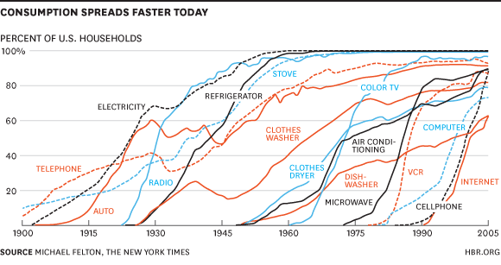
Notes:
AS YOU CAN SEE BY THE GRAPH ON THE SLIDE
DESPITE THE DISTANCE BETWEEN THE TWO AREAS IN THE PAST
THE MOBILE PHONE HAS ACTUALLY TAKEN A COURSE
THAT IS QUITE SIMILAR TO THE MOTOR VEHICLE

Slide 5
Notes:
BOTH INNOVATIONS HAVE NOW BECOME PART OF HOW SOCIETY OPERATES
THEY ARE BASIC INGREDIENTS IN THE DAILY RHYTHM OF SOCIAL LIFE
THUS, CARS AND PHONES HAVE CHANGED SOCIAL INTERACTION SO MUCH THAT…

Slide 6
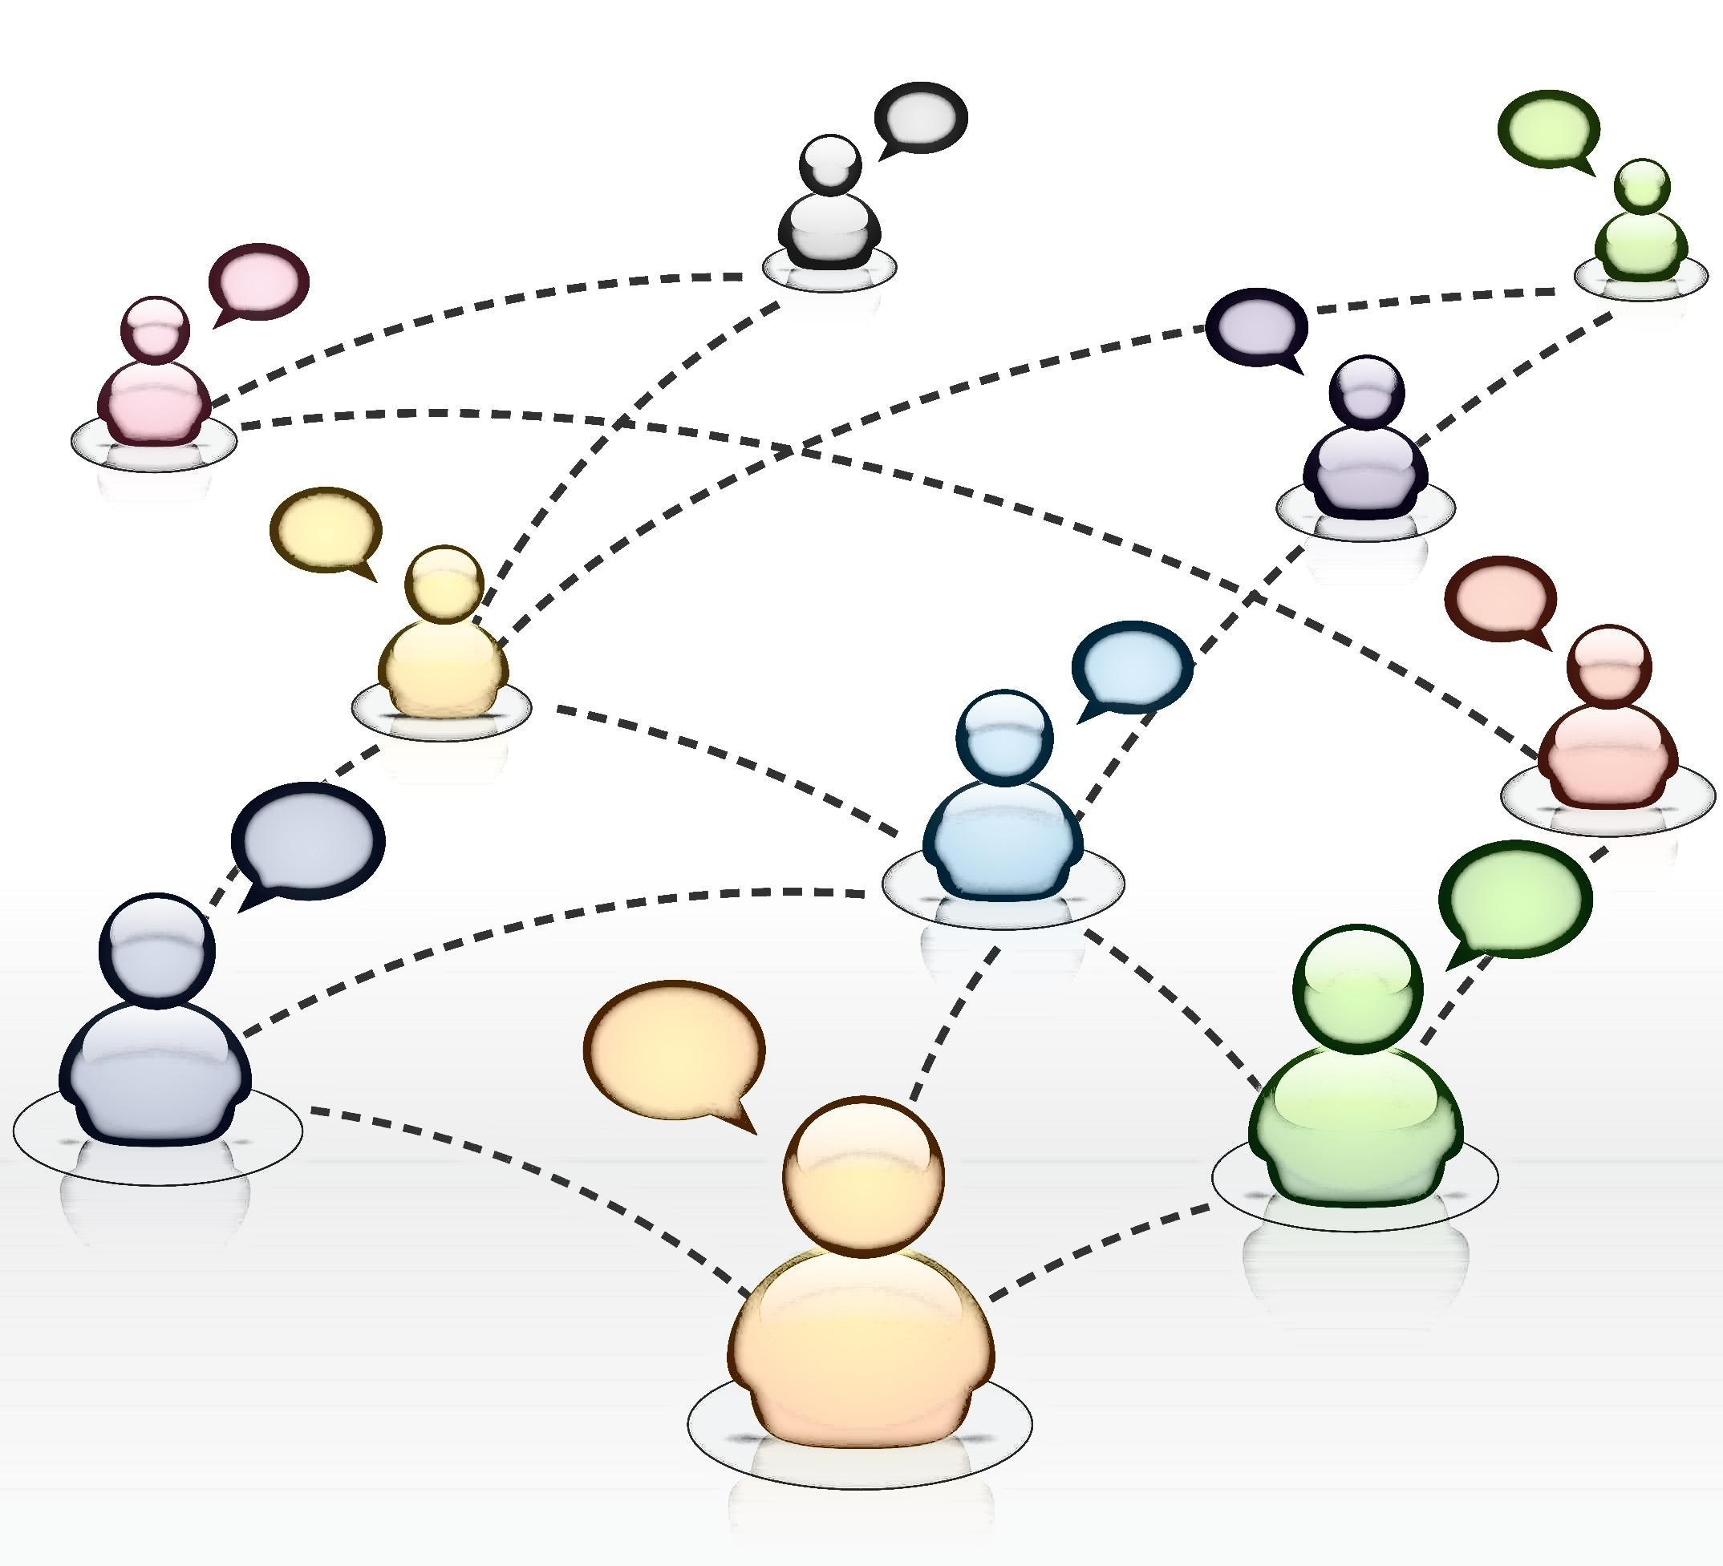
YOU
EVERYONE
KATZ RULE
Notes:
IT IS NOT JUST A PROBLEM FOR YOU
IF YOU DON’T HAVE A CELL PHONE OR A CAR (AT LEAST IN THE SUBURBS)
IT’S A PROBLEM FOR EVERYONE ELSE AROUND YOU
THIS REALIZATION HAS COME TO BE KNOWN AS THE KATZ RULE

Slide 7
COMMUNICATION
COMMUNICATION
Notes:
STILL, ONE DIFFERENCE BETWEEN THE HISTORIES OF PHONES AND CARS
IS THAT THE MOBILE PHONE
IS THE FASTEST SPREADING TECHNOLOGY OF ALL TIME
AND THIS REFLECTS SOMETHING SPECIAL ABOUT THE UNDERLYING USE OF MOBILE PHONES
SLOW

Slide 8
COMMUNICATION
COMMUNICATION
1) Eating
2) Drinking
3) Sleeping
4) Leisure
5) Social
6) Media
7) Hygiene
8) Sex
9) Work
10) Tobacco
11) Alcohol
12) Coffee
13) Spending
14) Exercise
Notes:
TAKING A STEP BACK, I THINK IT IS IMPORTANT
TO POSITION COMMUNICATION IN THE BROADER PICTURE OF LIFE GOALS
HERE I HAVE LISTED THE TOP 14 MOMENT-TO-MOMENT DESIRES
BASED UPON A RECENT EXPERIENCE SAMPLING STUDY
WHICH IS A METHOD FOR SURVEYING PEOPLE ON THEIR PHONES DURING THE COURSE OF DAILY LIFE

Slide 9
COMMUNICATION
1) Eating
2) Drinking
3) Sleeping
4) Leisure
5) Social
6) Media
7) Hygiene
8) Sex
9) Work
10) Tobacco
11) Alcohol
12) Coffee
13) Spending
14) Exercise
Notes:
THE ORDER, THOUGH, REFLECTS THE MOST FREQUENT SELF-CONTROL FAILURES
AND WHAT BECOMES CLEAR FROM THE HIGH RANKING OF OF SOCIAL AND MEDIA DESIRES
IS THAT COMMUNICATION IS NOT ONLY A MAJOR PART OF OUR LIVES
BUT ALSO SOMETHING WE STRUGGLE TO CONTROL THROUGHOUT LIFE

Slide 10
DECISION MAKING
GOOD
BAD
“ADDICTION”
“NOMOPHOBIA”
“DISORDERS”
“COMPULSIONS”
Notes:
NOW A KEY DIFFERENCE IN MY ANGLE COMING FROM COMMUNICATIONS
IS THAT I STUDY HOW ALL PEOPLE
USE THESE TECHNOLOGIES
FOR BOTH GOOD AND BAD DECISION MAKING

Slide 11
DECISION MAKING
SOCIAL COGNITION
“ADDICTION”
“NOMOPHOBIA”
“DISORDERS”
“COMPULSIONS”
Notes:
I DO THIS BY FOCUSING ON UNDERLING DECISION MAKING PROCESSES SUCH AS MORE AUTOMATIC OR CONTROLLED FORMS OF SOCIAL CONGITION
AS OPPOSED TO ASSIGNING NEGATIVE LABELS TO EXTREME USERS LIKE ADDICTION
WHILE IT MAY APPEAR THAY MOBILE PHONES ARE ADDICTIVE TO SOME PEOPLE,
THIS OBSCURES HOW ALL OF OUR MINDS HAVE BEEN REWIRED IN THE 21ST CENTURY
AND THE GREAT BENEFITS THEY PROVIDE TO INDIVIDUALS AND SOCIETIES

Slide 12
DRIVING
Notes:
BECAUSE AS YOU ALL KNOW,
DISTRACTED DRIVING IS NOT JUST A PROBLEM OF A FEW SELECT INDIVIDUALS
THIS IS A COMMON OCCURRENCE IN DAILY LIFE ITS HARD TO WALK DOWN THE SIDEWALK
WITHOUT NOTICING HALF OF DRIVERS ON THEIR SMARTPHONES

Slide 13
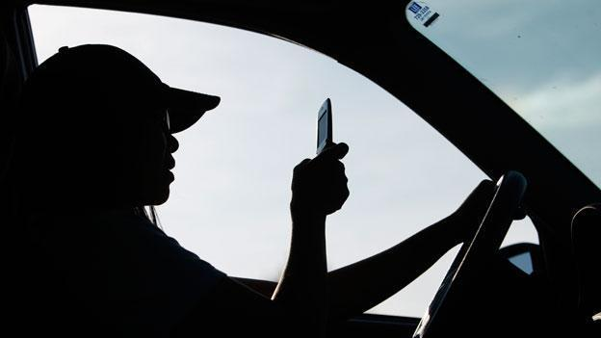
DRIVING
Notes:
FOR THIS REASON, MORE UNIVERSAL COMMUNICATION PERSPECTIVES
ARE ESSENTIAL TO EXPLAINING – AND SOLVING
THE PERSISTENT PROBLEM OF DISTRACTED DRIVING IN SOCIETY
IN CONTRAST TO OTHER RESEARCH ON DANGEROUSNESS

Slide 14
WHY?
Communication
Distracted Driving
Notes:
TAKING A COMM VIEWPOINT ALLOWS US TO TACKLE THE QUESTION OF WHY
WHY THESE BEHAVIORS ARE SO COMMONPLACE
DESPITE AN ABUNDANCE OF RESEARCH SHOWING THAT PEOPLE KNOW IT IS DANGEROUS

Slide 15
WHY?
Information
Psychology
Communication
Neuroscience
Distracted Driving
Notes:
TO HELP WITH THE WHY QUESTION, I DRAW ON A NUMBER OF COMPLEMENTARY PERSPECTIVES
THAT OVERLAP WITH COMMUNICATION PROCESSES
INCLUDING INFORMATION, PSYCHOLOGY, AND NEUROSCIENCE

Slide 16
MY RESEARCH
Surveys
Experience Sampling
Logged Data
Experiments
Neuroimaging
Driving Simulation
Notes:
AND I UTILIZE A VARIETY OF METHODS
IN COLLABORATION WITH MY COLLEAGUES AT MICHIGAN AND UPENN
BUT FOR THIS PRESENTATION I WILL EMPHASIZE OUR SURVEY WORK
AS WELL AS THE POTENTIAL OF NEUROSCIENCE TO LOOK AT ROOT CAUSES OF BEHAVIORS

Slide 17
GOAL FOR TODAY
1. Consciousness and Mobile Devices
2. Consciousness and Personality Traits
3. Consciousness and Social Factors
Notes:
MY OVERARCHING GOAL FOR TODAY
IS TO SHED SOME LIGHT ON THREE FACTORS RELATED TO CONSCIOUSNESS
FIRST, THE ROLE OF CONSCIOUSNESS IN USING MOBILE PHONES SPEFICALLY
SECOND, THE IMPORTANCE OF CONSCIOUSNESS IN PERSONALITY TRAITS
AND THIRD, THE INTERPLAY OF CONSCIOUSNESS AND SOCIAL FACTORS

Slide 18
1. CONSCIOUSNESS
Notes:
SO WHAT DO I MEAN BY CONCSCIOUSNESS?
MY WORK HAS FOCUSED ON IS HOW PEOPLE UTILIZE THESE NEW SOCIAL TOOLS
MOBILE DEVICES AND SOCIAL MEDIA
IN MORE AND LESS CONSCIOUS MODES AT DIFFERENT MOMENTS IN DAILY LIFE
AND HOW DOING SO CAN HAVE BOTH POSITIVE AND NEGATIVE CONSEQUENCES

Slide 19
1. CONSCIOUSNESS
AUTOMATIC
DEGREE
Notes:
ON THE ONE HAND, OUR PHONES HAVE BECOME INGRAINED IN HOW WE THINK
AS WE USE THEM MORE, WE RELY LESS AND LESS ON HIGHER LEVEL COGNITION IN SIMPLER TERMS, THEY BECOME AUTOMATIC BEHAVIORS
WHICH PSYCHOLOGICALLY MEANS THAT THE BEHAVIORS LACK FOUR THINGS:
AWARENESS, ATTENTION, CONTROL, AND INTENTION

Slide 20
1. CONSCIOUSNESS
AUTOMATIC
IMMERSION
DEGREE
Notes:
YET ITS NOT AS SIMPLE AS THE MORE WE DO IT, THE MORE AUTOMATIC IT IS
SURPRISINGLY, WE HAVE FOUND THAT SOME PEOPLE ARE TIED TO THEIR DEVICES
IN BOTH HIGHLY UNCONSCIOUS WAYS – WHAT I HAVED CALLED AUTOMATIC
AND ALSO HIGHLY CONSCIOUS WAYS – WHAT I REFER TO AS IMMERSION
AND YOU CAN SEE WHEN PEOPLE ARE FULLY ABSORBED IN THEIR PHONES

Slide 21
1. CONSCIOUSNESS
AUTOMATIC
IMMERSION
DEGREE
FREQUENCY
Notes:
IN OTHER WORDS, THE SAME PEOPLE ARE MORE LIKELY TO ENGAGE WITH THEIR PHONES WITH A GREATER DEGREE OF MINIMUM CONSCIOUSNESS AND MAXIMUM CONSCIOUSNESS
SO OVERALL PEOPLE SEEM TO BE WIRED TO DEVICES WITH MULTIPLE FORMS OF CONSCIOUSNESS

Slide 22
1. CONSCIOUSNESS
Enlightened?
More Conscious
NORMAL
Less Conscious
Dead
Notes:
THE POINT HERE IS THAT OUR BEHAIVOR
IS NOT SIMPLY CONSCIOUS OR UNCONSCIOUS WHEN WE ARE TEXTING
INSTEAD, WE CAN VIEW IT ALONG A SPECTRUM
THAT VARIES FROM MOMENT TO MOMENT
AND PERSON TO PERSON

Slide 23
1. CONSCIOUSNESS
Enlightened?
More Conscious
NORMAL
Less Conscious
Dead
Notes:
AND TODAY I FOCUS ON THE LOWER CONSCIOUS SIDE OF THE SPECTRUM
WHICH WE HAVE FOUND TO BE ESPECIALLY RELEVANT TO TWD
PSYCHOLOGICALLY THIS END OF THE SPECTRUM IS KNOWN AS AUTOMATICITY,
AS I JUST DISCUSSED A MOMENT AGO, BUT I’M HAPPY TO DISCUSS IMMERSION AT THE END OF TODAY

Slide 24
1. CONSCIOUSNESS
Enlightened?
HABITS
More Conscious
NORMAL
Less Conscious
Dead
Notes:
HABITS REPRESENT ONE SPECIFIC FORM OF LESS CONSCIOUS BEHAVIOR
THEY ARE DIFFERENT FROM OTHER AUTOMATIC BEHAVIOR SBECAUSE THEY ARE DEFINED BY HAVING A TRIGGER – ALSO KNOWN AS A CUE
WHICH ONCE ACTIVATED
SETS OFF A WAVE LESS CONSCIOUS BEHAVIOR

Slide 25
1. CONSCIOUSNESS
Enlightened?
CUES
More Conscious
NORMAL
Less Conscious
Dead
Notes:
IMPORTANTLY, I ARGUE THAT MOBILE DEVICE HABITS
ARE PSYCHOLOGICALLY DISTINCT FROM HABITS OF THE PAST
DUE TO A MUCH MORE COMPLEX SET OF “CUES”
EACH OF WHICH CAN DIRECT OUR BEHAVIOR WITHOUT US REALIZING IT
AND EACH PERSON HAS THEIR OWN PERSONAL SET OF CUES

Slide 26
1. CONSCIOUSNESS
Enlightened?
CUES
More Conscious
NORMAL
Less Conscious
Dead
Notes:
BECAUSE OF THIS, UNDERSTANDING THE TYPES OF CUES
IS IMPERATIVE TO UNDERSTANDING HOW THESE BEHAVIORS OPERATE DIFFERENTLY
SO I WANT TO GO THROUGH SOME OF THE MAIN FORMS THEY COME IN

Slide 27
1. CONSCIOUSNESS
Enlightened?
CUES
Features
Sensory
More Conscious
NORMAL
Less Conscious
Dead
Notes:
FIRST, THE LARGE NUMBER OF SMARTPHONE FEATURES
ALLOWS FOR MANY MORE CUES TO DEVELOP THAN ANY OTHER ONE OBJECT
SECOND, THESE TECHNOLOGIES ACTIVELY REACH OUT TO US
USING SENSATIONS LIKE VIBRATIONS, LIGHTS, AND SOUNDS THAT OUR BRAIN READS UNCONSCIOUSLY IN THE BACKGROUND

Slide 28
1. CONSCIOUSNESS
Enlightened?
CUES
Features
Sensory
Internal
External
Social
More Conscious
NORMAL
Less Conscious
Dead
Notes:
BUT CUES ARE NOT RESTRICTED TO THE PHONE ITSELF
SPECIFIC MENTAL STATES LIKE ANXIETY AND BOREDOM
CAN BECOME TRIGGERS FOR PICKING UP THE PHONE
AND SPECIFIC ENVIRONMENTS OR SITUATIONS CAN BECOME TIED TO PHONE ACTIVITY
THIS IS PARTICULALRY RELEVANT IN CONTEXTS WE VISIT A LOT – SUCH AS OUR OWN CAR
FINALLY, THESE HABITS CAN BECOME TRIGGERED BY SOCIAL FACTORS AS I WILL RETURN TO

Slide 29
STUDY 1
1. CONSCIOUSNESS
ONLINE SURVEY
441 MICHIGAN UNDERGRADUATES
CROSS-SECTIONAL
ANAYSIS: OLS REGRESSIONS
DV = TEXTING WHILE DRIVING FREQUENCY
Notes:
ALTOGETHER, I ARGUE THESE SPECIAL CHARACTERISTICS OF MOBILE HABITS MORE GENERALLY
COME TO BE INFLUENTIAL IN THE MOTOR VEHICLE
IN OUR FIRST STUDY ON THIS IDEA, PUBLISHED IN 2012
WE SURVEYED UNDERGRADS ON THEIR TEXTING TENDENCIES

Slide 30
FREQUENCY
AUTOMATICITY
Notes:
AND THE FIRST THING WE DID WAS UNTANGLE FREQUENCY OF USE FROM CONSCIOUSNESS
BECAUSE IN GENERAL DOING SOMETHING MORE MAKES IT AUTOMATIC
HOWEVER, A LARGE BODY OF RESEARCH NOW SHOWS THE HABIT STRENGTH – OR AUTOMATICITY
IS ONLY BASED IN PART ON THE NUMBER OF TIMES YOU DO SOMETHING

Slide 31
FREQUENCY
AUTOMATICITY
“I text…”
Never
Monthly
Weekly
Daily
Hourly
“Texting is something I start before I realize I’m doing it.”
Not at all
Slightly
Somewhat
Mostly
Completely
Notes:
LOOKING AT SOME EXAMPLE SURVEY WORDING GIVES YOU A BETTER SENSE
FOR HOW SURVEYS OF HABIT STRENGTH HAVE BEEN VALIDATED EXPERIMENTALLY
AND USED TO GET AT SOMETHING VERY DIFFERENT FROM MERE FREQUENCY
WHEREAS FREQUENCY TELLS YOU THE QUANTITATIVE RATE OF THE BEHAVIOR,
AUTOMATICITY TELLS YOU THE QUALITATIVE MANNER
IN WHICH THE PERSON DOES THE BEHAVIOR WHEN IT OCCURS

Slide 32
FREQUENCY
AUTOMATICITY
Less More
Automatic Automatic
Notes:
WHAT THIS LEAVES US WITH CONCEPTUALLY IS TWO AXIS
TWO TEXTERS, THEN, CAN TEXT THE SAME AMOUNT
BUT DIFFER IN HOW AUTOMATICALLY THEY ARE ORIENTED TOWARD THEIR MOBILE PHONE
SLOW

Slide 33
Automaticity
Frequency
Texting while Driving
Confidence
Intentions
Behavioral Control
Attitudes
Norms
Notes:
MOVING ON, OUR FINAL RESULTS DEMONSTRATED WHY THE SEPARATION WAS IMPORTANT
AS WE HYPOTHESIZED, FINDINGS REVEALED
THAT PEOPLE WITH A MORE AUTOMATIC ORIENTATION TOWARD TEXTING WERE MUCH MORE LIKELY TO TEXT WHILE DRIVING

Slide 34
RESULTS
VARIABLE | β | t VALUE
GENDER | .03 | 0.65
AGE | -.05 | -1.09
CONFIDENCE | .19** | 4.47
FREQUENCY | .18** | 3.88
AUTOMATICITY | .25** | 5.48
CONSIOUS NORMS | .41** | 9.19
CONSCIOUS ATTITUDES | .07 | 1.45
CONSCIOUS CONTROL | .02 | 0.48
TOTAL R² | 37.9**
Notes:
YOU CAN FOLLOW THE COLORS FROM THE DIAGRAM TO THE STATASTICAL TABLE
I PROMISE THIS IS THE ONLY TIME I SHOW NUMBERS
AND WHAT WE FIND IS THAT AUTOMATICITY IS A STRONG PRECDITOR
EVEN WHEN CONTROLLING FOR FREQUENCY
AND OTHER CONSCIOUS VARIABLES LIKE ATTITUDES AND NORMS

Slide 35
2. PERSONALITY TRAITS
Notes:
NOW YOU MIGHT WONDER:
DOES THIS LESS CONSCIOUS CONNECTION WITH ONE’S PHONE
SIMPLY REFLECT ONE’S PERSONALITY IN GENERAL
SO WE DECIDED TO STUDY THE RELATIONSHIP BETWEEN MOBILE PHONE HABITS
AND CONSCIOUSNESS AT THE PERSONALITY LEVEL

Slide 36
2. PERSONALITY TRAITS
AUTOMATIC
HABIT
ORIENTATION
SELF-CONTROL
DEGREE
MINDFULNESS
Notes:
WHAT WE ARE GETTING AT IS THE CONCEPTS OF MINDFULNESS AND SELF-CONTROL
WHICH ARE TWO DIFFERENT FORMS OF OUR ABILITY TO SELF-REGULATE OUR OVERALL BEHAVIOR

Slide 37
2. PERSONALITY TRAITS
AUTOMATIC
HABIT
ORIENTATION
SELF-CONTROL
DEGREE
MINDFULNESS
Notes:
SO WE COLLECTED DATA ON TEXTING-SPECIFIC HABITS JUST AS WE DID IN STUDY 1
AND WE PERFORMED A PATH ANALYSES TO LOOK AT HOW THEY RELATED TO MIDNFULNESS AND SELF-CONTROL
BOTH OF THESE CONCEPTS CAN BE BROKEN DOWN FURTHER INTO DIMENSIONS
SO FOR NOW I JUST WANT TO MENTION THE MAIN FINDINGS

Slide 38
MINDFUL
NONJUDGE
d
-0.27
-0.23
MINDFUL
DESCRIBE
d
AUTOMATIC
-0.45
0.47
MINDFUL
AWARE
d
0.15
IMMERSION
MINDFUL
NONREACT
d
MINDFUL
OBSERVE
d
Notes:
FOR MINDFULNESS, FINDINGS SHOWED THAT THERE IS A RELATIONSHIP SUCH THAT MORE AUTOMATIC TEXTERS ARE MORE LIKELY TO BE MINDLESS PEOPLE
HOWEVER, THIS WAS ONLY A MODERATE CORRELATION

Slide 39
Fig. 5 Self-Control Path Analysis
-0.22
AUTOMATIC
SELF-CONTROL
RESTRAINT
d
0.40
0.47
IMMERSION
SELF-CONTROL IMPULSIVITY
d
Notes:
LIKEWISE, MORE AUTOMTIC TEXTERS
WERE MORE LIKELY TO REPORT HAVING LESS SELF-CONTROL
BUT THIS WAS ALSO JUST A MODERATE CORRELATION

Slide 40
2. PERSONALITY TRAITS
Notes:
SO AFTER FINDING THAT THESE HABITS AND PERSONALITY TRAITS
ARE RELATED BUT DIFFERENT FROM ONE ANOTHER
WE DECIDED TO SEE HOW THEY MATCH UP IN TERMS OF PREDICTING DD
SINCE SEPARATERESEARCH HAS SHOWN THAT BOTH
TRAIT MINDFULNESS AND SELF-CONTROL ALSO PREDICT DD

Slide 41
STUDY 2
2. PERSONALITY TRAITS
ONLINE SURVEY
1000 PARTICIPANTS
CROSS-SECTIONAL
ANAYSIS: OLS REGRESSIONS
DV1 = TEXTING WHILE DRIVING
DV2 = TEXTING WHILE WALKING
Notes:
TO DO THIS, WE COLLECTED A NEW SURVEY SAMPLE OF ABOUT 1000 PEOPLE
TO CONSIDER HOW THE THREE FACTORS
TEXTING AUTOMATICITY, TRAIT MINDFULNESS, AND TRAIT SELF-CONTROL
ALL PLAY A ROLE IN TEXTING WHILE DRIVING
AND THE NEWER CONCERN OF TEXTING WHILE WALKING ACROSS THE STREET

Slide 42
WALKING
FREQUENCY
TEXTING
FREQUENCY
TEXTING WHILE WALKING
TEXTING
AUTOMATICITY
TRAIT
SELF-CONTROL
TEXTING WHILE DRIVING
TRAIT
MINDFULNESS
DRIVING
FREQUENCY
Notes:
HERE IS THE BASIC MODEL WITHOUT THE PATHS FOR THE THREE KEY PREDICTORS
FIRST WE CONTROL FOR FREQUENCY OF TEXTING
AND FREQUENCY OF TEXTING WHILE DRIVING AND WALKING

Slide 43
WALKING
FREQUENCY
TEXTING
FREQUENCY
TEXTING WHILE WALKING
TEXTING
AUTOMATICITY
TRAIT
SELF-CONTROL
TEXTING WHILE DRIVING
TRAIT
MINDFULNESS
DRIVING
FREQUENCY
Notes:
THEN WHEN WE ADD IN THE PERSONALITY FACTORS
WHICH REPLICATE PREVIOUS FINDINGS BY OTHERS
TRAIT SELF-CONTROL AND TRAIT MINDFULNESS
PREDICT THE RATE OF BOTH TWD AND TWW

Slide 44
WALKING
FREQUENCY
TEXTING
FREQUENCY
TEXTING WHILE WALKING
TEXTING
AUTOMATICITY
TRAIT
SELF-CONTROL
TEXTING WHILE DRIVING
TRAIT
MINDFULNESS
DRIVING
FREQUENCY
Notes:
FINALLY, WHEN WE ADD IN TEXTING AUTOMATICITY
WE FIND THAT IT IS UNIQUELY SIGNIFICANT FOR BOTH DRIVING AND WALKING
BEYOND THE TRAIT FACTORS AND OUR OTHER CONTROLS

Slide 45
WALKING
FREQUENCY
TEXTING
FREQUENCY
TEXTING WHILE WALKING
TEXTING
AUTOMATICITY
TRAIT
SELF-CONTROL
TEXTING WHILE DRIVING
TRAIT
MINDFULNESS
DRIVING
FREQUENCY
Notes:
AND INTERESTINGLY – AUTOMATICITY – THE DEGREE OF PHONE HABIT STRENGTH
IS EVEN MORE PREDICTIVE OF TEXTING WHILE WALKING THAN DRIVING
I’M GOING TO MOVE ON THE NEXT SECTION
BUT I’M HAPPY TO DISCUSS WHY WE THINK THIS MIGHT BE AT THE END

Slide 46
3. SOCIAL FACTORS
Notes:
OKAY SO THUS FAR EVERYTHING I HAVE PRESENTED HAS BEEN ON THE INDIVIDUAL LEVEL
BUT AS I MENTIONED BEFORE, MOBILE DEVICE HABITS ARE DISTINCT
DUE THEIR RELATIONSHIP WITH SOCIAL FACTORS

Slide 47
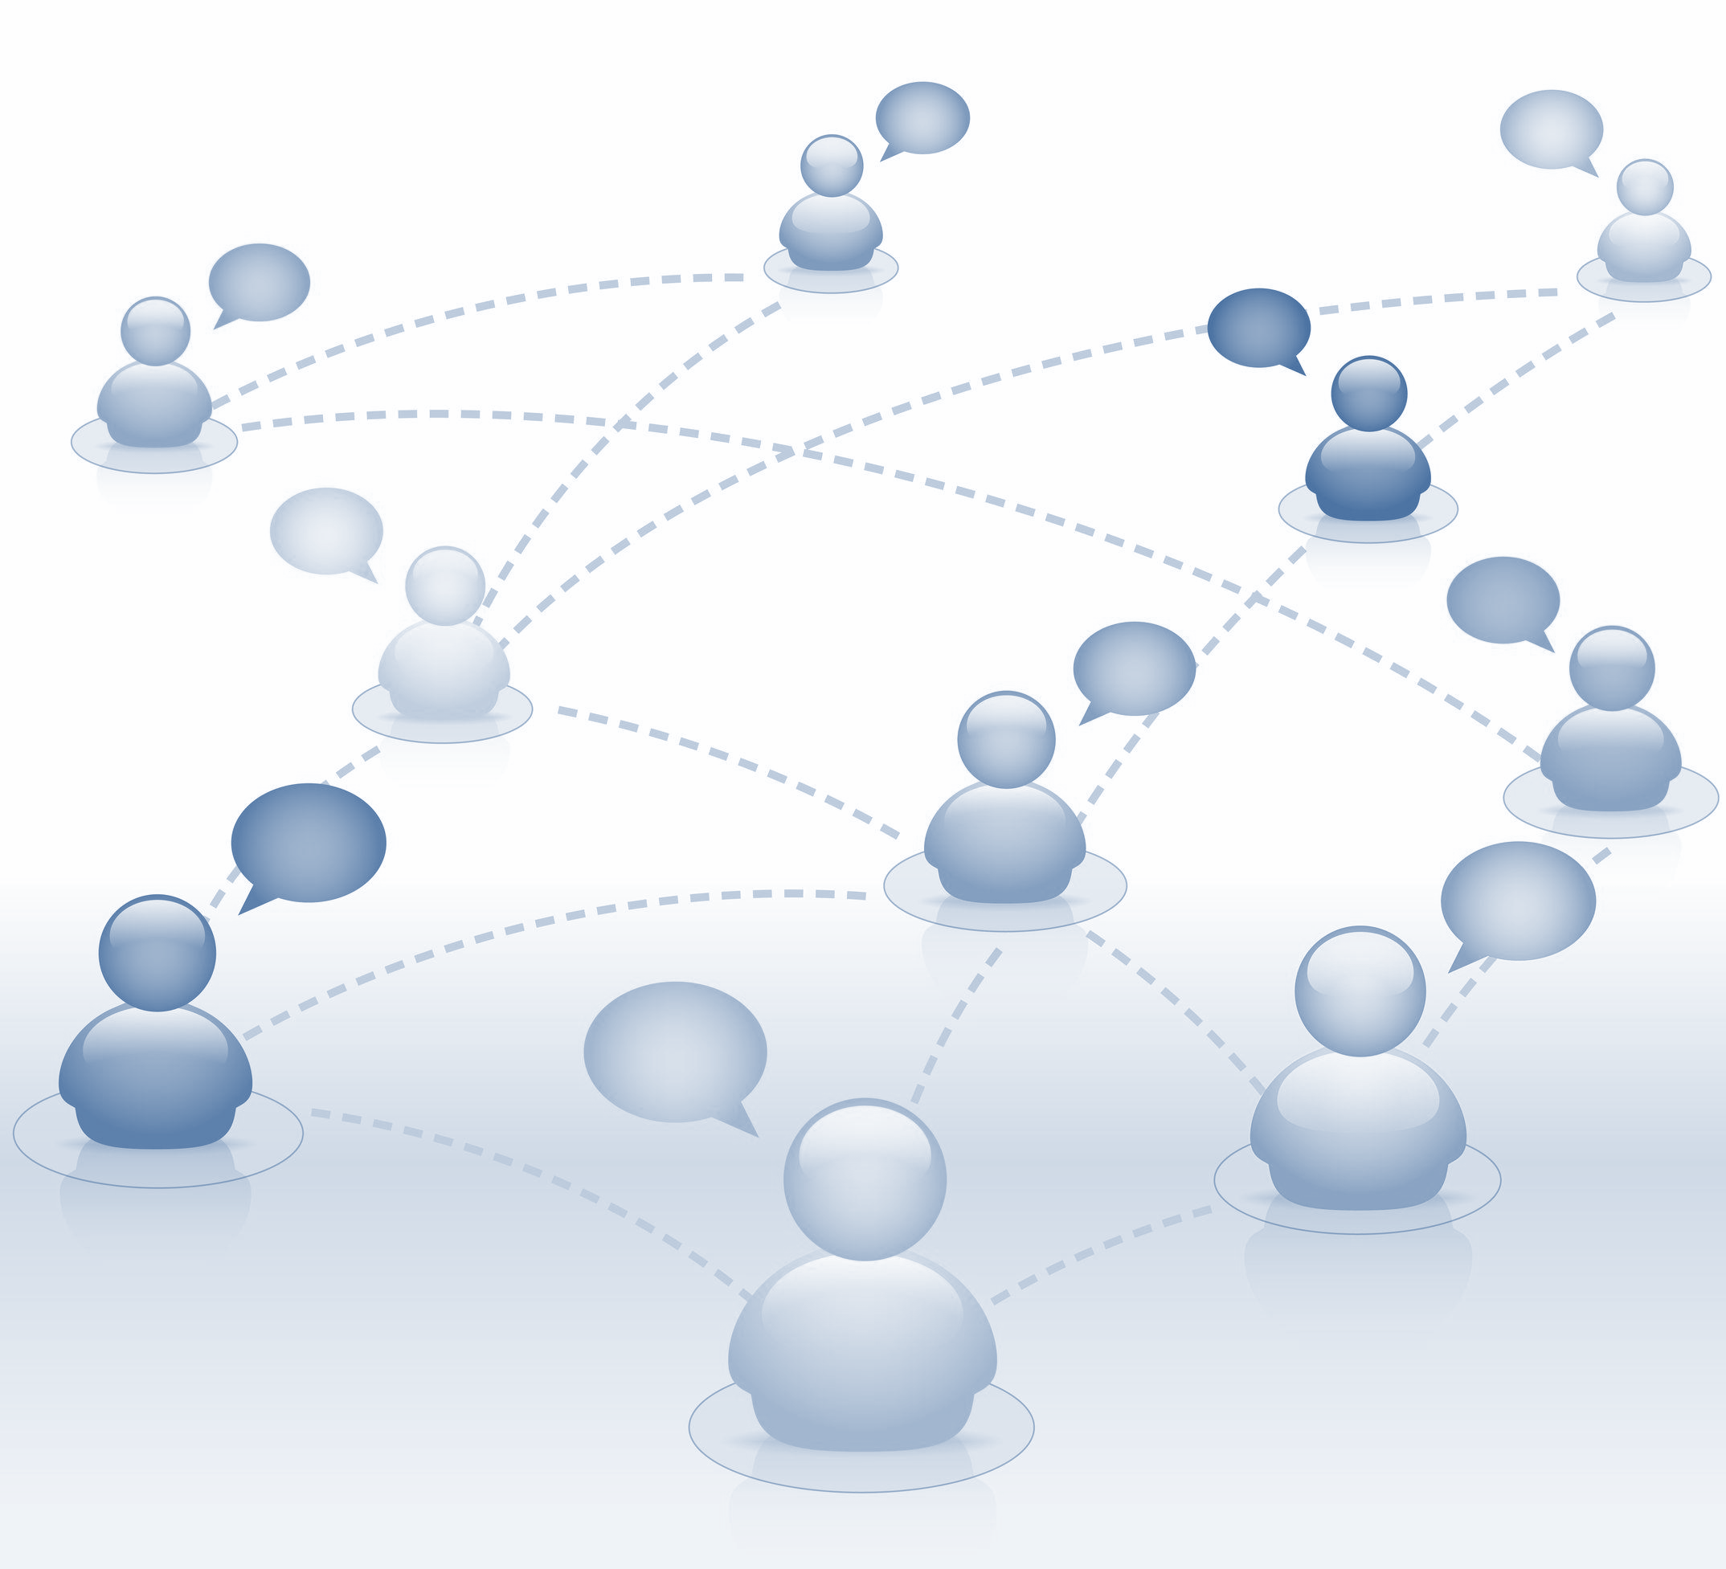
3. SOCIAL FACTORS
Notes:
THEREFORE, IN ORDER TO UNDERSTAND DD
WHAT BECOMES EVIDENT IS THAT WE MUST CONSIDER
HOW THE INDIVIDUAL PROCESSES INTERACT
WITH THE SOCIAL CONTEXTS AROUND THEM

Slide 48
STUDY 3
3. SOCIAL FACTORS
PART 1: fMRI NEUROIMAGING
PART 2: DRIVING SIMULATOR
80 NEW MALE DRIVERS
ANAYSIS: OLS REGRESSIONS
DV = RISKY DRIVING
Notes:
SO NOW I WANT TO INTRODUCE A NEW STUDY
IN WHICH WE USE FMRI BRAIN SCANNING IN COMBINATION WITH A DRIVING SIM
TO TEST HOW HABITUAL PROCESSES AT THE BRAIN LEVEL
INTERACT WITH SOCIAL CONTEXT IN THE MOTOR VEHICLE

Slide 49
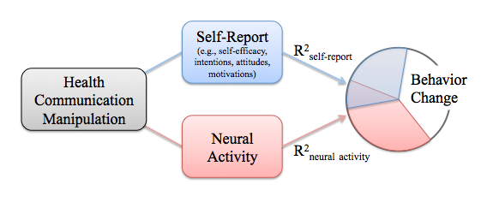
Notes:
THIS RESEARCH HIGHLIGHTS THE BRAIN-AS-PREDICTOR APPROACH
ADVANCED BY MY COLLABORATOR AND FACULTY ADVISOR EMILY FALK
NOW AT THE UNIVERSITY OF PENNSYLVANIA

Slide 50
Notes:
IN WHICH WE COLLECT NEURAL RESPONSES WHILE PEOPLE UNDERGO BRAIN IMAGING
AND WE USE THESE NEURAL RESPONSES
TO EXPLAIN REAL WORLD BEHAVIOR LATER ON
ABOVE AND BEYOND SELF-REPORT

Slide 51
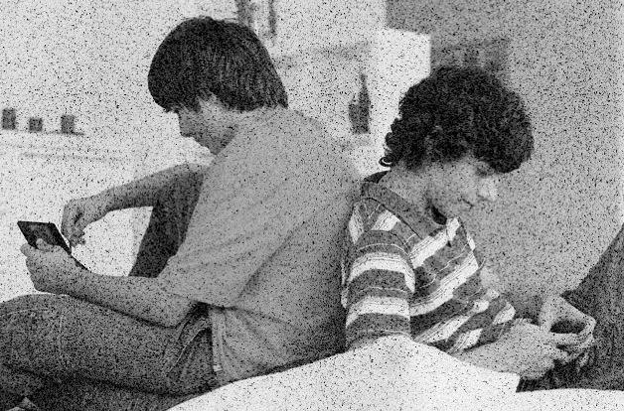
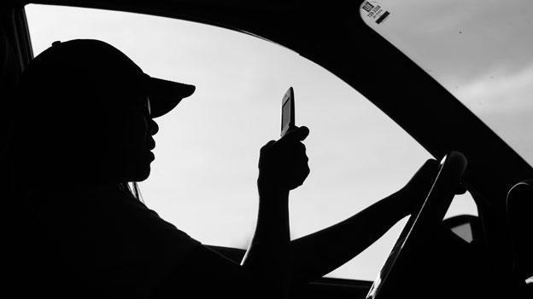
Underlying Processes
Real World Outcomes
Notes:
NEURAL MEASURES ARE DISTINCT BECAUSE THEY HAVE THE POTENTIAL
BOTH TO SHED LIGHT ON THE UNDERLYING PROCCESSES IN EVERYDAY COMMUNICATION
AND FURTHER LINK THEM TO DOWNSTREAM OUTCOMES LIKE DISTRACTED DRIVING

Slide 52
3. PSYCH AND SOCIAL
A
“GO-NO-GO”
Habit Override Task
C
F
Go
Trials
X
No-Go Trial
Notes:
HERE YOU CAN SEE HOW ONE TASK THAT WE USE WORKS
THIS TASK IS CALLED THE GO-NO-GO AND MEASURES WHETHER PEOPLE CAN OVERRIDE A HABIT
EACH TRIAL PRESENTS A LETTER
TO DEVELOP A NEW HABIT OF PRESSING A BUTTON AFTER A LETTER CUE

Slide 53
3. PSYCH AND SOCIAL
A
PRESS
BUTTON
Notes:
LET ME DEMONSTRATE HOW THIS WORKS
A PERSON PRESSES A BUTTON WHENEVER A NEW LETTER APPEARS
SUCH AS FOR THE LETTER A
THIS IS CALLED A GO TRIAL

Slide 54
3. PSYCH AND SOCIAL
A
C
PRESS
BUTTON
Notes:
THE PERSON PRESSES AGAIN WHEN A NEW LETTER C COMES UP

Slide 55
3. PSYCH AND SOCIAL
A
C
F
PRESS
BUTTON
Notes:
AND DOES THE SAME FOR EVERY OTHER NEW LETTER

Slide 56
3. PSYCH AND SOCIAL
A
C
F
DON’T PRESS!
X
Notes:
EXCEPT…
FOR WHEN X APPEARS
IN WHICH CASE THEY MUST OVERRIDE THE LETTER HABIT
AND THIS WHAT WE CALL A NO-GO TRIAL

Slide 57
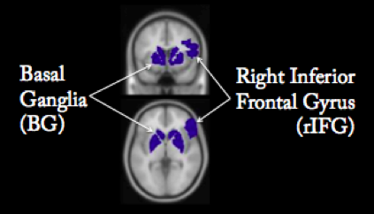
Notes:
AFTER PARTICIPANTS HAVE COMPLETED THIS TASK IN THE FMRI
WE CAN THEN TEST HOW MUCH THEY RESPONDED IN KEY BRAIN REGIONS
AS YOU CAN SEE, THE BLUE AREA SHOWS GREATER NEURAL ACTIVITY IN SPECIFIC REGIONS
AND INDEXES GREATER ABILITY TO OVERRIDE HABITS

Slide 58
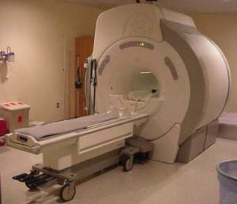
Notes:
OUR RESEARCH LAB HAS ALREADY SHOWN THAT WE CAN USE THIS METHOD
TO PREDICT RISKY DRIVING IN A DRIVING SIMULATOR ONE WEEK AFTER A BRAIN SCAN
LET ME PROVIDE AN EXAMPLE OF THIS LINE OF WORK
LED BY MY COLLABORATORS EMILY FALK AND THE UMTRI

Slide 59
RISKY PEER
NON-RISKY PEER
Notes:
IN ONE STUDY WE COMPLETED
HALF OF PARTICIPANTS DROVE IN THE DRIVING SIMULATOR
WITH A PEER WHO APPROVED OF RIKSY DRIVING
AND A SECOND DROVE WITH ONE WHO DISAPPROVED OF RIKSY DRIVING

Slide 60
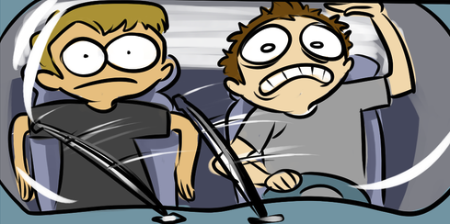
RISKY PEER
NON-RISKY PEER
Notes:
AND WHAT WE FIND IS THAT THE NEURAL RESPONSES
DURING THE HABIT OVERRIDE TASK – THE GO NO GO
PREDICTS SAFE DRIVING IN THE DRIVING SIMULATOR
BUT ONLY FOR PEOPE WHO DROVE WITH RISK AVERSE PEER

Slide 61
3. PSYCH AND SOCIAL
A
“GO-NO-GO”
Habit Override Task
C
F
Go
Trials
X
No-Go Trial
Notes:
THIS EXAMPLE SHOWS HOW GENERAL HABITUAL PROCESSES INTERACT
WITH THE SOCIAL CONTEXT AROUND THEM IN THE MOTOR VEHICLE
BUT WE ARE NOW ADAPTING THIS METHOD FOR COMMUNICATION HABITS

Slide 62
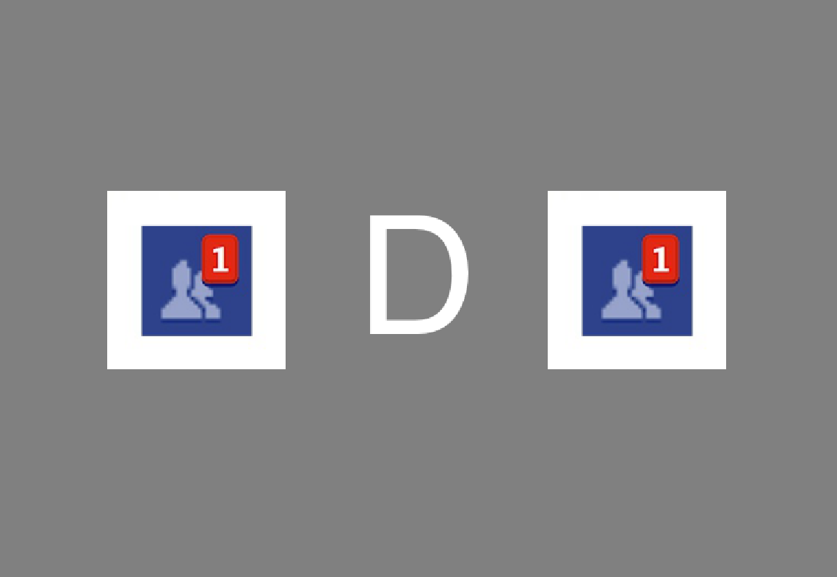
COMMUNICATION
“GO-NO-GO”
Notes:
AS YOU CAN SEE, WE HAVE ADJUSTED THE HABIT OVERRIDE TASK TO COMMUNICATION
BY ADDING IN SOCIAL MEDIA CUES AS DISTRACTORS
IN THIS CASE FACEBOOK SINCE EVERYONE KNOWS THEIR ICONS

Slide 63
Notes:
WE JUST FINISHED DATA COLLECTION ON THIS STUDY THIS SPRING
SO WE WILL SOON BE ABLE TO TEST HOW THE PRESENCE
OF COMMUNICATION CUES LIKE FACEBOOK NOTIFICATIONS IS DIFFERENT NEUROLOGICALLY
FROM OVERRIDING HABITS MORE GENERALLY

Slide 64
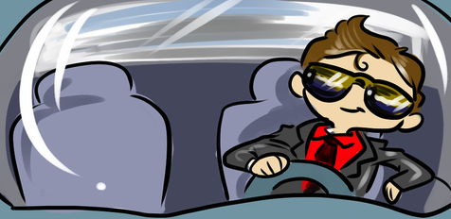
1 WEEK
LATER
SOLO DRIVE
SOCIAL DRIVE
Notes:
AND THEN WE CAN LOOK AT HOW THESE NEUROLOGICAL MEASURES
INTERACT WITH THE SURROUNDING SOCIAL CONTEXT IN THE MOTOR VEHICLE
SUCH AS DRIVING ALONE OR WITH OTHERS

Slide 65
GOALS FOR TODAY
Consciousness and Mobile Devices
Notes:
TO RETURN TO MY GOALS FOR TODAY,
I HAVE ARGUED THAT WE MUST TURN OUR ATTENTIOON TO THE THREE THINGS
FIRST, THE IMPORTANCE OF HOW CONSCIOUSNESS HAS COME
TO GUIDE OUR DECISION MAKING WITH COMM TECHNOLOGIES

Slide 66
GOALS FOR TODAY
Consciousness and Mobile Devices
Consciousness and Personality Traits
Consciousness and Social Context
Notes:
SECOND, I HAVE SHOWN HOW THIS PHONE HABITS RELATE TO
BUT ARE DISTINCT FROM PERSONALITY FORMS OF CONSCIOUSNESS
AND THIRD, I HAVE ILLUSTRATED HOW PERSONAL HABITS
CAN INTERACT WITH SOCIAL FACTORS –
WHICH ARE ESPECIALLY RELEVANT IN THE MOTOR VEHICLE

Slide 67
BIG PICTURE
Automaticity
Individual
Notes:
AS A WHOLE, THESE STUDIES AND IDEAS CONVEY THE POWER
OF MORE AUTOMATIC ORIENTATIONS TOWARD MOBILE DEVICES
IN EXPLAINING WHY DISTRACTED DRIVING OCCURS

Slide 68
BIG PICTURE
Automaticity
Individual
Social
Notes:
BUT I HAVE LEFT OUT ONE MAJOR COMMUNICATION PERSPECTIVE
AND THIS IS THE IDEA OF TAKEN FOR GRANTEDNESS
ADVANCED BY MY COLLABORATOR AND SOCIOLOGIST RICH LING
WHICH CONCERNS HOW UNCONSCIOUSNESS ALSO OPERATES AT THE SOCIETAL LEVEL

Slide 69
BIG PICTURE
Automaticity
Accessibility
Individual
Social
Notes:
TAKEN FOR GRANTEDNESS IS BASED ON ACCESSIBILITY
AS MEMBERS OF SOCIETY, AS WELL AS FAMILIES AND RELATIONSHIPS
WE ARE EXPECTED TO BE AVAILABLE TO ONE ANOTHER NO MATTER WHAT
WE DON’T THINK ABOUT IT CONSCIOUSLY,
BUT THIS SOCIAL FACTOR OPERATES AT ALL TIMES

Slide 70
BIG PICTURE
Automaticity
Accessibility
Individual
Social
Notes:
THE POINT BEING THERE ARE ACTUALLY TWO TYPES OF UNCONSCIOUS PROCESSES
PERSONAL HABITS THAT I HAVE TALKED ABOUT TODAY
AND IMPLICIT EXPECATIONS OF ACCESSIBILITY
THAT ARE CONSTANTLY INTERACTING WITH ONE ANOTHER
AND IN DOING SO CAN UNDERCUT OUR CONSCIOUS GOALS LIKE DRIVING

Slide 71
TOWARD CHANGE
Notes:
SO… IF DISTRACTED DRIVING IS CAUSED BY MULTIPLE FORMS OF UNCONSCIOUS PROCESSES
THE NEXT QUESTION IS…
CAN WE EVEN DO ANYTHING ABOUT IT?

Slide 72
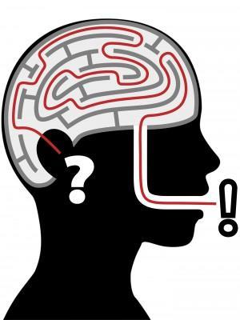
TOWARD CHANGE
Notes:
RESEARCH IN PSYCHOLOGY HAS SHOWN THAT WE ARE NOT GOOD AT RECOGNIZING THE TRUE CAUSES OF OUR HABITS
AND WE INCORRECTLY ASSUME THESE AUTOMATIC BEHAVIORS
REFLECT OUR INTENTIONS WHEN THEY DON’T

Slide 73
TOWARD CHANGE
Notes:
SO EVEN WHEN PEOPLE KNOW AND AGREE THAT THIS IS A RISKY BEHAVIOR
ANY OF THEIR PHONE CUES CAN PULL THE TRIGGER BEFORE THEY NOTICE WHAT IS GOING ON
OFTEN PEOPLE WILL RATIONALIZE IT AFTER THE FACT
AS PAUL ATCHLEY’S RESEARCH ON COGNITIVE DISSONANCE POINTS OUT
PERHAPS THE ROAD SEEMED SAFE AT THAT MOMENT
OR THEY WERE AT A STOP LIGHT WITH PLENTY OF TIME

Slide 74
PERSONAL CHANGE
Identify the Triggers
Notes:
BUT THESE RATIONALIZATIONS ARE OFTEN FALLACIES
THEREFORE, IN TERMS OF INCREASING SAFETY AT THE PERSONAL LEVEL
WE NEED TO TEACH PEOPLE TO BECOME COGNIZANT OF THEIR PERSONAL CUES
AS I WENT OVER BEFORE,
EACH PERSON HAS THEIR OWN REPERTOIRE OF MOBILE DEVICES CUES

Slide 75
PERSONAL CHANGE
Identify the Triggers
Rewire the Automatic Responses
Notes:
ONCE PEOPLE BECOME MORE AWARE OF THEIR CUES
WE NEED TO USE STRATEGIES TO REPROGRAM THE AUTOMATIC BEHAVIORS
IN ADDITION TO FIGHTING THE BAD HABITS WITH APPS AND ADS AS WE ARE DOING NOW
WE NEED TO TRANSFORM THE BAD HABITS INTO GOOD HABITS
AND A NUMBER OF PSYCHOLOGICAL TECHNIQUES EXIST THAT HOLD PROMISE FOR THIS

Slide 76
SOCIAL CHANGE
Build on existing message campaigns.
Notes:
AT THE SOCIETAL LEVEL, WE NEED TO EXPAND ON OUR CURRENT CAMPAIGNS
IT’S TIME TO GO BEYOND CONVINCING PEOPLE THAT ITS BAD TO TEXT
PEOPLE ASSUME THEY KNOW “WHY” THEY TEXTED WHILE DRIVING
BUT OUR RESEARCH WOULD SUGGEST THAT THEY DON’T

Slide 77
SOCIAL CHANGE
Build on existing message campaigns.
Notes:
GIVEN THE SOCIETAL NATURE OF THIS PROBLEM,
WE NEED TO CHOOSE STRATEGIES THAT
CAN EASILY ADAPT TO SOCIAL CAMPAIGNS
NOT JUST THINGS THAT WORK IN THE PSYCHOLOGY LAB

Slide 78
SOCIAL CHANGE
Build on existing message campaigns.
Build common triggers into the message.
Notes:
ONE PSYCHOLOGICAL APPROACH
THAT HAS BEEN SUCCESSFUL WITH CHANGING HABITS
USES AN IF THEN APPROACH TO INSERT GOOD HABITS OVER BAD HABITS
IF A CUE OCCURS, THEN DO THIS ISTEAD

Slide 79
IDENTIFY THE CUES
If your phone buzzes or blinks at you…
If you get bored…
If you are waiting for an email to arrive…
If you get lonely...
If you forgot to mention something….
If you are running late…
Notes:
IN DOING SO, WE CAN HIGHLIGHT COMMON TRIGGERS
THAT DRAW ATTENTION TO THE ROOT CAUSES OF TEXTING WHILE DRIVING
HERE ARE A FEW HYPOTHETICAL EXAMPLES

Slide 80
SOCIAL CHANGE
Build on existing message campaigns.
Build common triggers into the message.
Build specific responses into the message.
Notes:
AND THEN WE CAN INSERT REPLACEMENT RESPONSES
INTO THE ACTUAL MESSAGES WE SEND OUT SO THAT THERE ARE SPECIFIC WAYS FOR PEOPLE
TO LEARN TO OVERRIDE THE OLD HABITS WITH SAFER HABIT

Slide 81
REPROGRAM THE BEHAIVOR
…change the music.
…check the directions.
…check the speedometer.
…hand your phone to a passenger.
…check your mirrors.
…silence your phone.
Notes:
FOR INSTANCE, WE ALREADY HAVE GOOD HABITS THAT ARE ASSOCIATED WITH DRIVING
SUCH AS CHECKING THE MIRRORS
OR SAFER HABITS WITH SIMILAR REWARDS
SUCH AS CHANGING THE MUSIC AND

Slide 82
SOCIAL CHANGE
Build on existing message campaigns.
Build common triggers into the message.
Build specific responses into the message.
Notes:
THIS PERSPECTIVE REPRESENTS A NEW TERRAIN FOR SOCIAL CAMPAIGNS
THAT BUILDS ON THE SUCCESS OF CURRENT ADS IN SPREADING THE WORD
THE MORE WE RECOGNIZE THAT OUR FINGERS CAN ACT BEFORE OUR INTENTIONS
THE BETTER WE CAN BE AT SAVING LIVES

Slide 83
COMMUNICATION,
UNCONSCIOUSNESS,
AND DRIVING
Scott W. Campbell, University of Michigan
Emily B. Falk, University of Pennsylvania
Ethan Kross, University of Michigan
Sonya Dal Cin, University of Michigan
Chris Cascio, University of Pennsylvania
Matthew O’Donnell, University of Pennsylvania
Ray Bingham, University of Pennsylvania
Elliot Panek, University of Alabama
Notes:
I WANT TO THANK ALL OF MY COLLABORATORS AT MICHIGAN AND PENN
AND OF COURSE, THE STATE OF NEW YORK FOR LEADING THE PATH TOWARD CHANGE
IT IS NOW BEEN FOUR YEARS SINCE I FIRST WENT TO THE PA CAPITAL BUILDING TO PRESENT MY EARLY IDEAS ON THIS AS A DETERMINED UNDERGRADUATE
NOW I AM CONVINCED WE ARE READY TO IMPLEMENT THIS PERSPECTIVE INTO CURRENT CAMPAIGNS

