Slide 1
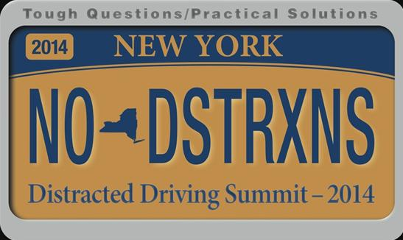
Federal Perspective on Distracted Driving
Thomas M. Louizou
Region 2 Administrator
National Highway Traffic Safety Administration
May 6, 2014

Slide 2
Distraction Data (FARS and GES)
In 2012, NHTSA estimates…
  3,328 were killed and 421,000 people were injured in a distraction-affected crash
  These numbers include all forms of distractions

Slide 3
Observed Use in 2012
5.0%
  Driver hand-held use
    This translates in 660,000 vehicles driven by someone using a hand-held cell phone at a typical daylight moment
1.5%
  Driver’s visibly manipulating hand-held devices (texting)
Hand-held phone use highest among 16-24 year-olds

Slide 4
National Telephone Survey on Distracted Driving Attitudes and Behaviors
While driving…
  28% people who always or almost always answer a call
  6% make calls
  14% send texts
  Source: National Telephone Survey on Distracted Driving Attitudes and Behaviors – 2012, April 2013 (DOT HS 811 729)

Slide 5
Naturalistic Driving Study
NHTSA’s study shows visual-manual tasks associated with hand-held phones and other portable devices increased the risk of getting into a crash by three times.
The study did not find a direct increased crash risk from the specific act of talking on a cell phone.
  However, the manual-visual interactions involved with using a hand-held phone made its overall use nearly twice more risky, since the use of these devices involve visual-manual tasks 100% of the time.
  Even portable hands-free and in-vehicle hands-free cell phone use was found to involve visual-manual tasks at least 50% of the time, which are associated with higher risk.
  Source: The Impact of Hand-Held And Hands-Free Cell Phone Use on Driving Performance and Safety-Critical Event Risk, April 2013 (DOT HS 811 757)

Slide 6
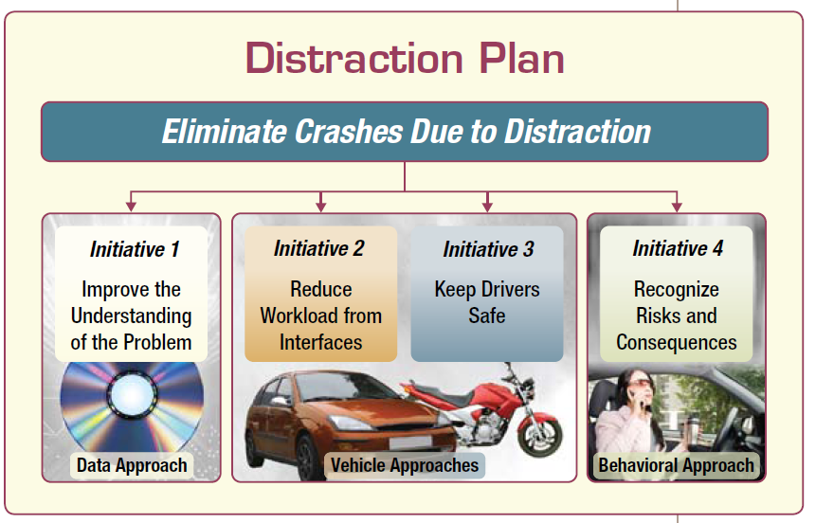
NHTSA’s Driver Distraction Program Plan
NHTSA Goal: Eliminate Crashes Due to Distraction

Slide 7
Proven Practices

Slide 8
Behavioral Approaches
Public awareness
Strong laws and policies
High Visibility Enforcement (HVE)
  enforcement supported by intense media

Slide 9
State Laws
43 states, D.C., Puerto Rico, Guam and the U.S. Virgin Islands ban text messaging for all drivers.
  All but 5 have primary enforcement.
12 states, D.C., Puerto Rico, Guam and the U.S. Virgin Islands prohibit all drivers from using hand-held cell phones while driving.
37 states and D.C. ban all cell phone use by novice drivers.

Slide 10
High Visibility Enforcement Model
Defined period of earned media
Defined period of paid media with an enforcement message
Defined period of enforcement
Evaluation before, during and after periods of publicity and enforcement

Slide 11


Tagline and Logo

Slide 12

U Drive. U Text. U Pay.
www.youtube.com/USDOTNHTSA

Slide 13
Research and Demonstration

Slide 14
Syracuse, NY & Hartford, CT Distracted Driving Demos
In 2009 NHTSA launched two pilot tests of HVE programs to assess whether increased law enforcement combined with media can get drivers to put down their cell phones and focus on the road.
Results – high visibility enforcement can reduce talking or texting using a hand-held cell phone
Hand-held cell phone use dropped 57% in Hartford (from 6.8% to 2.9%) and 32% in Syracuse (from 3.7% to 2.5%).
Texting while driving declined 72% in Hartford (from 3.9% to 1.1%) and 32% in Syracuse (from 2.8% to 1.9%).

Slide 15
What We Learned…
Awareness about cell phone use and texting was remarkably high.
Enforcement was strong; police in both sites issued a large number of tickets in both sites, many times above previous benchmark levels.
Citations for texting violations were low, demonstrating the difficulty of enforcing texting while driving.

Slide 16
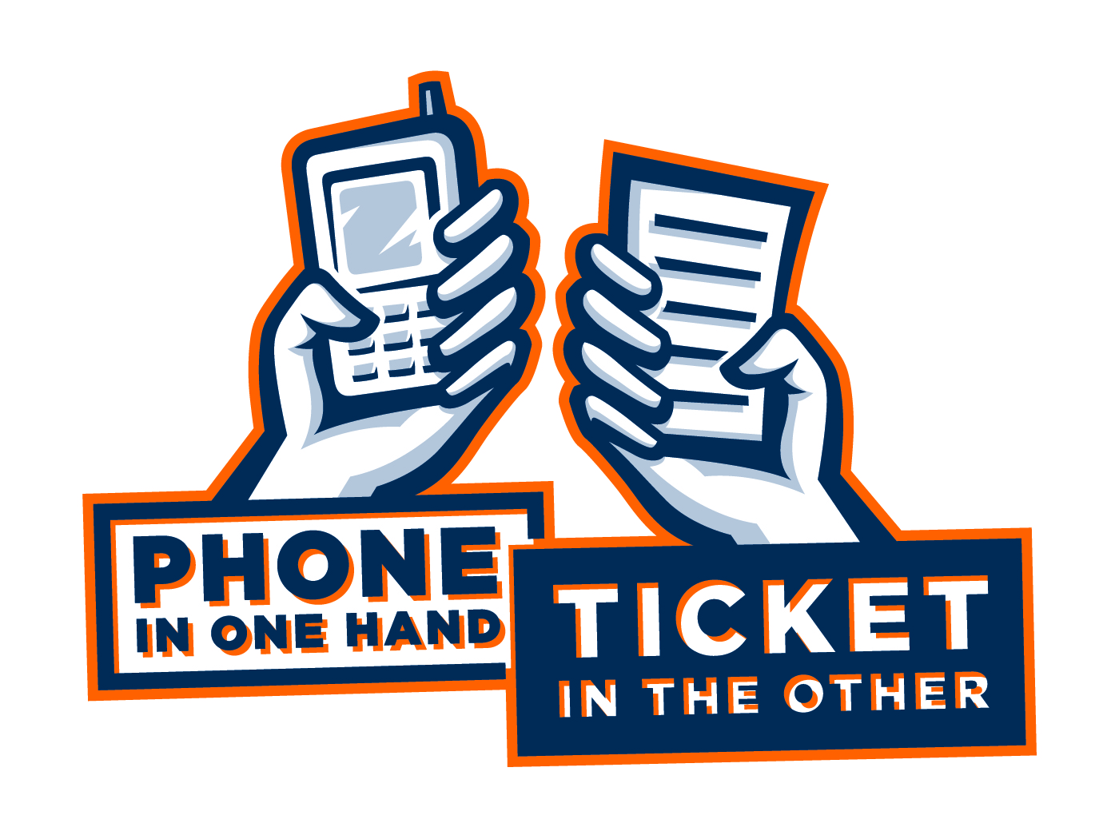
California & Delaware Distracted Driving Demonstration Projects
Having learned that HVE is effective in a controlled community setting, the next step was to determine if this strategy is feasible on a widespread basis.
  CA’s program took place in the Sacramento valley region (4 million residents over 9 counties)
  DE’s program was conducted statewide (900,000 residents)
Both locations conducted three waves of HVE and used the Phone in One Hand. Ticket in the Other slogan.

Slide 17
Results
CA
  Hand-held use decreased from 4.1% (baseline) to 2.7% (final post).
    The comparison area of Portland also showed a decrease (from 2.9% to 1.4%) over the same period. Analysis indicated this was likely to due to a proposed legislative effort in OR.
DE
  Drivers’ showed a significant decrease from 4.5% to 3.0%.
    This decrease was significantly greater than the decreases in the combined control areas in NJ and CT.

Slide 18
Results continued…
CA
  10,700 distracted driving citations.
  Recognition of the message Phone in One Hand. Ticket in the Other quadrupled from 16% (baseline) to 57% (post).
DE
  5,600 distracted driving citations.
  Message recognition doubled (from 7% to 15%).
Widespread distracted driving HVE deployment is feasible!

Slide 19
Massachusetts & Connecticut Texting Ban Demo
NHTSA is partnering with Connecticut and Massachusetts test the enforceability of texting bans.
Two waves have been completed, and two additional waves will be conducted by Fall 2014.
While different techniques work best in different areas, both Massachusetts and Connecticut are finding techniques that can be effective for enforcing texting bans.

Slide 20
Distracted Driving Enforcement Tips
From past and current projects, NHTSA has demonstrated a variety of successful enforcement techniques.
Enforcement agencies are unique; there’s no one size fits all approach.

Slide 21
Enforcement Techniques
Elevated vehicles
Spotters
Unmarked, semi-marked or low profile vehicles
Motorcycles
Routine and Saturation Patrols

Slide 22
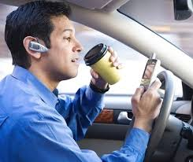
Detecting a Violation – Visual Cues
Nodding and looking down
Improper lane travel
Inconsistent speed
Delayed/slow starts
Typical signs of a DUI

Slide 23
Vehicle Initiatives

Slide 24
Guidelines for Auto Manufacturers
In April 2013 DOT/NHTSA released distraction guidelines to encourage manufacturers to limit the distraction risk connected to electronic devices built into their vehicles, such as communications, entertainment and navigation devices.
The voluntary guidelines establish specific recommended criteria for electronic devices installed in vehicles at the time they are manufactured that require drivers to take their hands off the wheel or eyes of the road to use them.
Notes:
The guidelines include recommendations to limit the time a driver must take his eyes off the road to perform any task to two seconds at a time and twelve seconds total. The guidelines also recommend disabling several operations unless the vehicle is stopped and in park, such as:
Manual text entry for the purposes of text messaging and internet browsing
Video-based entertainment and communications like video phoning or video conferencing
Displays of certain types of text, including text messages, web pages, social media content.

Slide 25
Phase 2 Guidelines for Auto Manufacturers
NHTSA is planning to develop a second set of guidelines to address portable and aftermarket devices, including electronic devices such as smart phones, electronic tablets and pads, and other mobile communications devices.
A third set of guidelines is planned to address voice-based user interfaces for both integrated and portable and aftermarket devices

Slide 26
Connected Vehicles
NHTSA will begin taking steps to enable vehicle-to-vehicle (V2V) communication technology for light vehicles.
This technology will improve safety by allowing vehicles to "talk" to each other and ultimately avoid many crashes by exchanging basic safety data, such as speed and position, ten times per second.

Slide 27
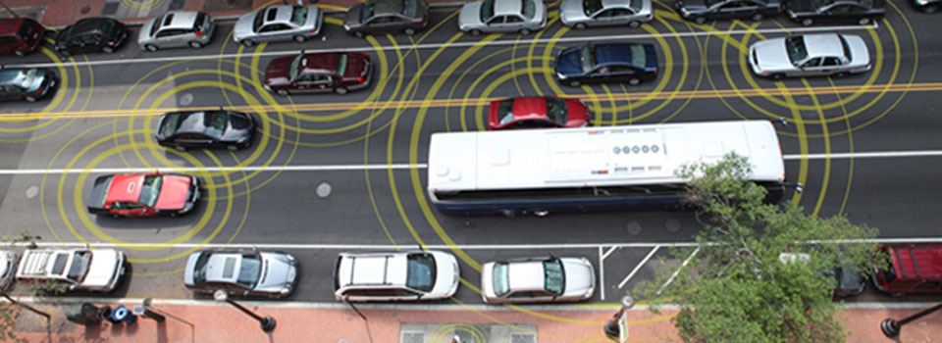
Vehicle to Vehicle (V2V)
Vehicle to Infrastructure (V2I)

Slide 28
NHTSA Resources
Available on Trafficsafetymarketing.gov
Earned Media Materials
  Prepared press release
  Op-ed
  Proclamation
  Fact sheet
National Data
Enforcement Tips
FAQ’s

Slide 29
Thank you
For more information please visit:
www.trafficsafetymarketing.gov
&
www.distraction.gov

