Slide 1
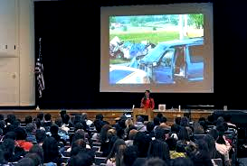
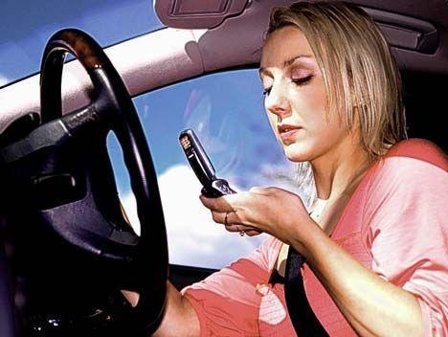
New York State Governor’s Traffic Safety Committee Distracted Driving Outreach
Distracted Driving Summit
May 6, 2014
Chuck DeWeese
Assistant Commissioner

Slide 2
Reality or Insanity???

Slide 3
Speaking of INSANITY!!

Slide 4
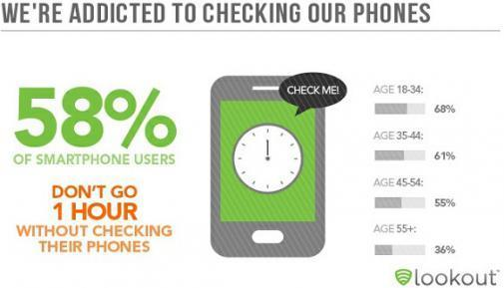
FEELING ADDICTED

Slide 5
Behavioral Change
- IS S - L- O - W
REQUIRES PATIENCE
REQUIRES MULTI-PRONGED APPROACH TO STOP THE UNDESIRABLE BEHAVIOR

Slide 6
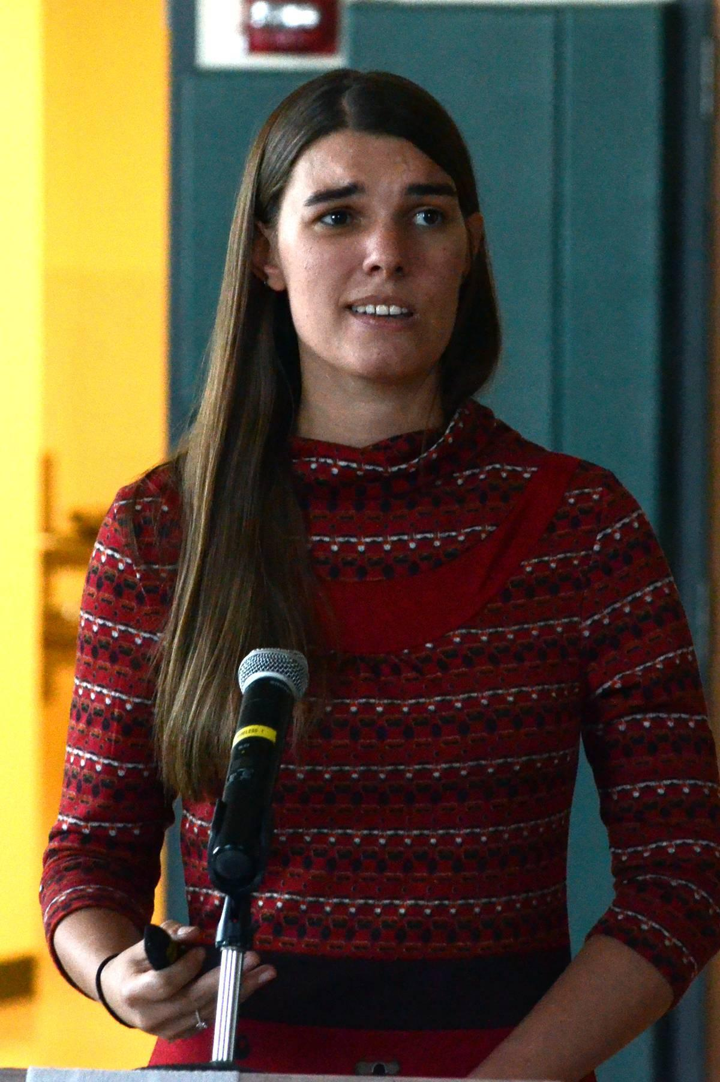
National Safety Council Victim Advocate Grant
High Schools
Victim Impact Panels
Traffic Safety Professionals
Notes:
The NSC grant was started as a pilot in FY2012 (2011)
Grant was in-place but wasn’t gaining traction

Slide 7
How does this happen?
Networking ……
GTSC Young Driver Toolkit http://www.safeny.ny.gov/SRO-Toolkit/default.html
Law Enforcement/SRO
Traffic Safety Boards
Principal Group meetings
SADD Chapters – Newsletter
NSC media efforts

Slide 8
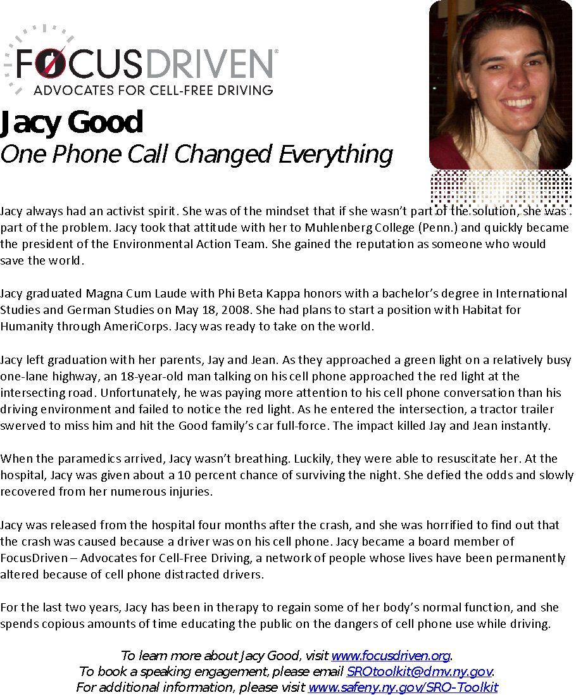
NSC – Year 2
Biography
Introduction
Media Advisory
Press Release
Survey

Slide 9
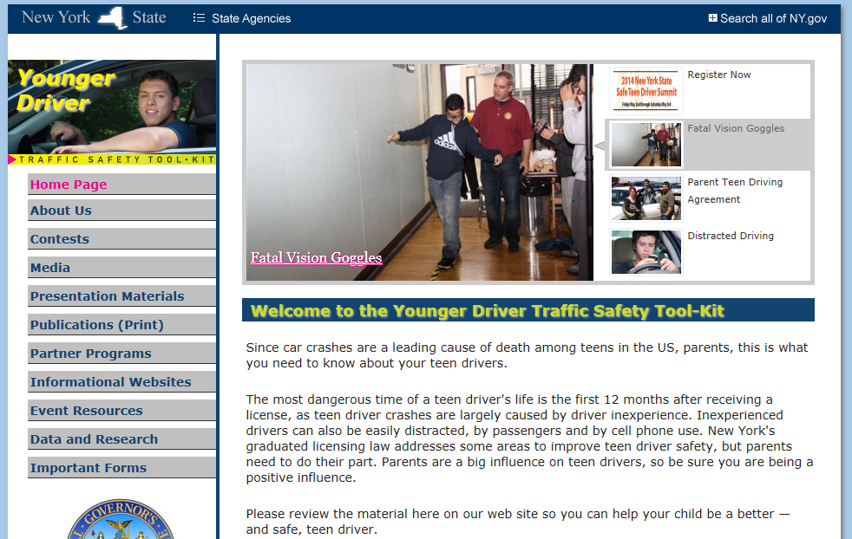
Notes:
Static display of the Young Driver Toolkit
Display Jacy’s picture with bio on the slider to promote the program

Slide 10
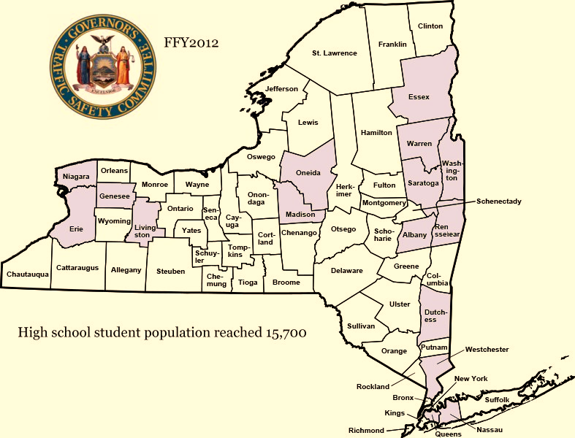
Notes:
40 appearances
First request was in November 2011 for driving simulator
Promoted this initiative with Jacy – initially Jacy & Steve together
Finished the 40th appearance on September 28, 2012.

Slide 11
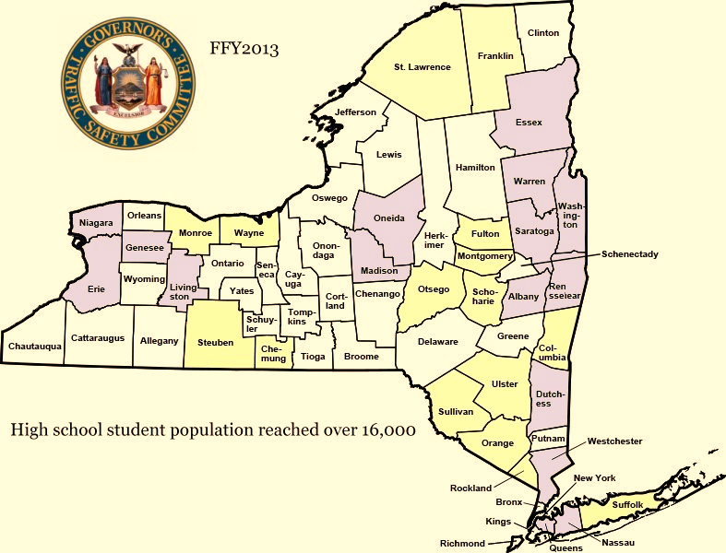
Notes:
A few changes happened in FY2013
Appearances increased to 60
NSC became more involved – added bio for distribution & media component
First appearance at VIP in Warren County – October 2012
60 appearances booked by February 2013 – info taken off toolkit
Turned away – 5 schools

Slide 12
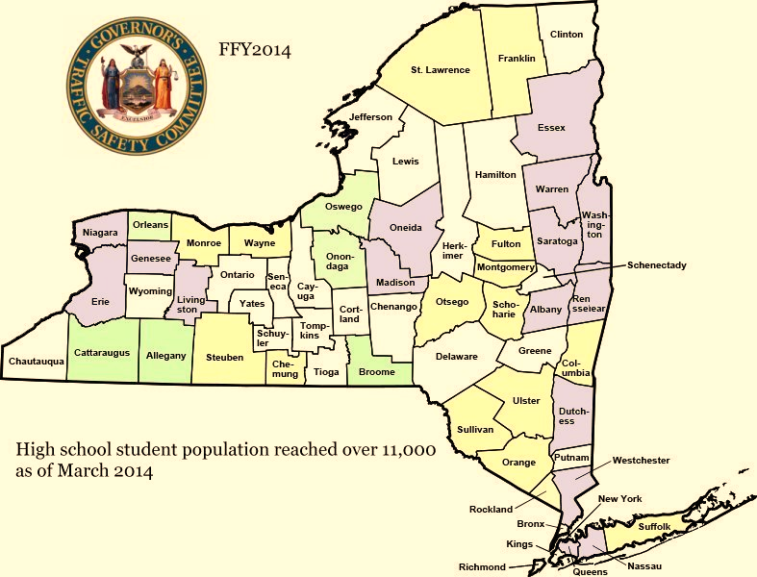
Notes:
Filled all appearances by December 2013.
Increased outreach to stakeholders i.e. magistrates, District Attorneys
Appearances booked by December.

Slide 13
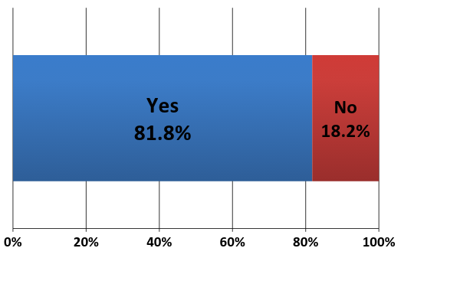
Prior to this presentation,
have you used your cell phone
while driving?
Notes:
Other survey questions
Did the audience learn;
about the dangers of cell phone use?
about the dangers of the cell phone conversation? that hands-free devices offer no safety benefit?
about the dangers of texting while driving?
Did you learn anything new about the dangers of cell phone use while driving?
Please provide examples of how behaviors have changed with audience members.
Response: Teachers, adults and students from audiences have told me that they now put their phone in the glove compartment while driving to avoid the urge to answer or text.

Slide 15
Participant Comments
Student – “She is a beautiful person inside and out. I can promise, I will NEVER use my cell phone while driving”
VIP – “It’s all dangerous, but I am impacted. I am going to put my phone in the trunk when I get in the car.”
LE – “Very touching and emotional.
Was a great presentation, nothing else needed.” Integration of Department values -100%

Slide 16
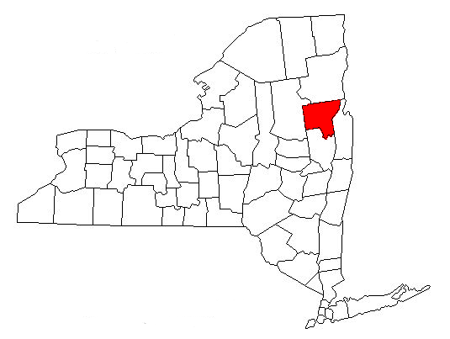
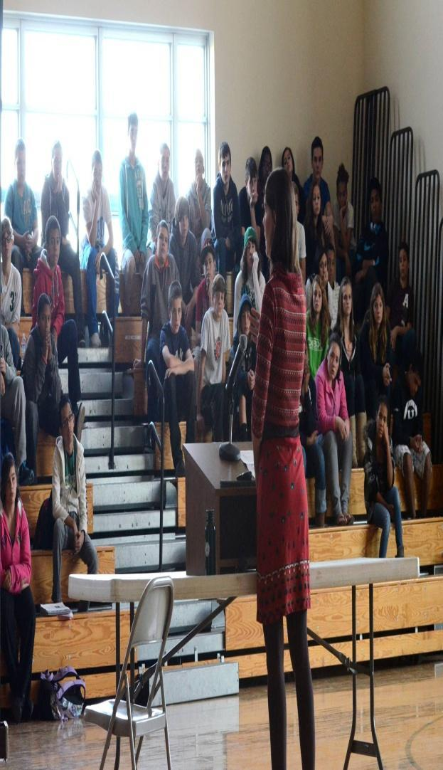
Warren County
Schools & VIP over 4,000 people
Notes:
Have been to over 60% of the schools in Warren County – Many are asked for another appearance by Jacy. 3,000+ students
VIP 1,000+

Slide 17
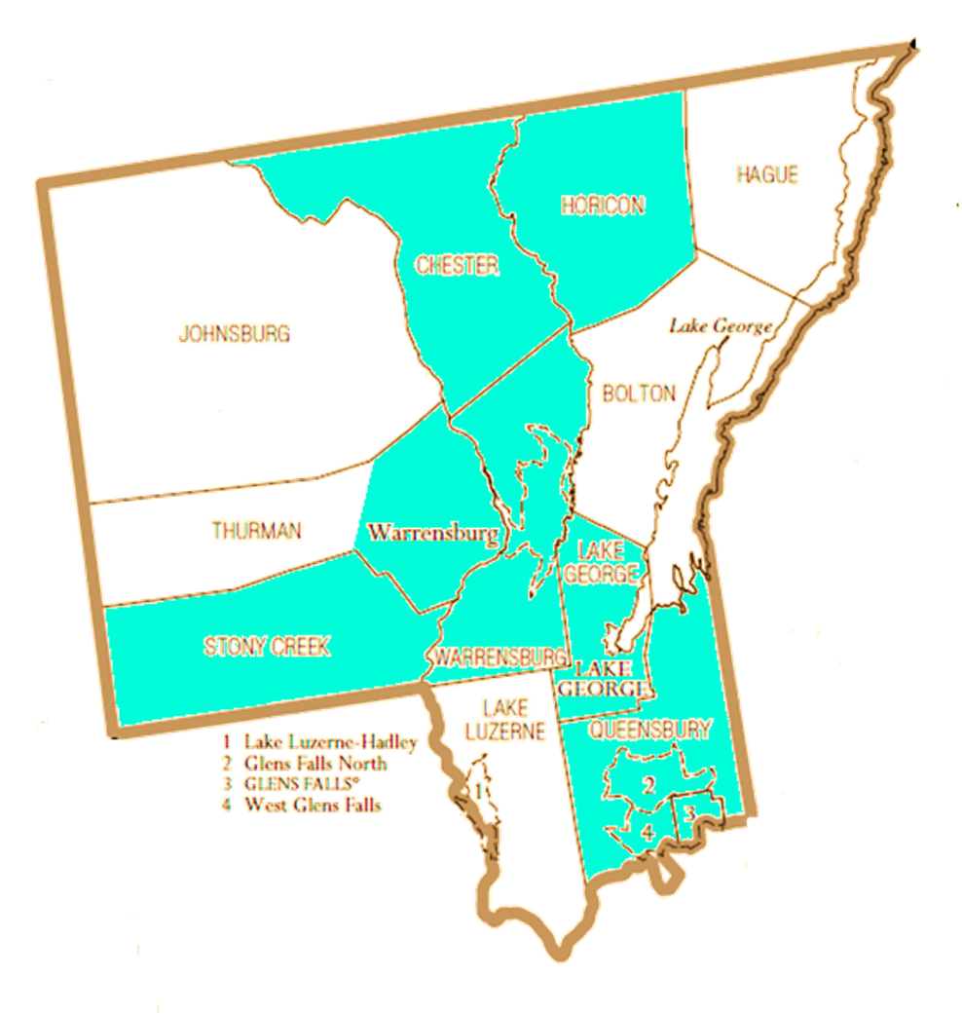
Victim Impact Program
Distracted Driving Victim Impact Panel
Saw increase in DD crashes &tickets
Created Fall 2011 - Partnership with Courts
Mandatory Attendance for DD plea reduction
40-50 offenders appearing per month
$25 fee for participants
Jacy Good appearances
Notes:
Jacy – Participates in VIP each month – primarily paid directly, 2 grant funded.

Slide 18
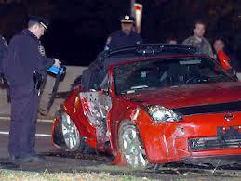
VIP Trends
The number of DD tickets issued is stable
Warren County referrals consistent
Expanding to Washington County
Plea offer based on the facts, circumstances, and prior history.
Courts generally honor the plea offer
Dutchess County Under 21 VIP

Slide 19
Perception
“The interesting thing was noting defendants reactions during attendance. Many offenders come to the panel with the attitude that they don’t belong there and it’s just a waste of everyone’s time. After listening to victims, like Jacy Good, many people approach us after and let us know they have a completely different opinion about distracted driving now.”
Chief William Valenza VIP Coordinator

Slide 20
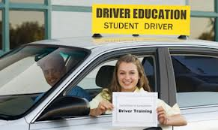
Additional Outreach
NYS Magistrates Association
NYS District Attorney Association
NYS Driver &Traffic Safety Educators
Driver Education Research Innovation Center

Slide 21
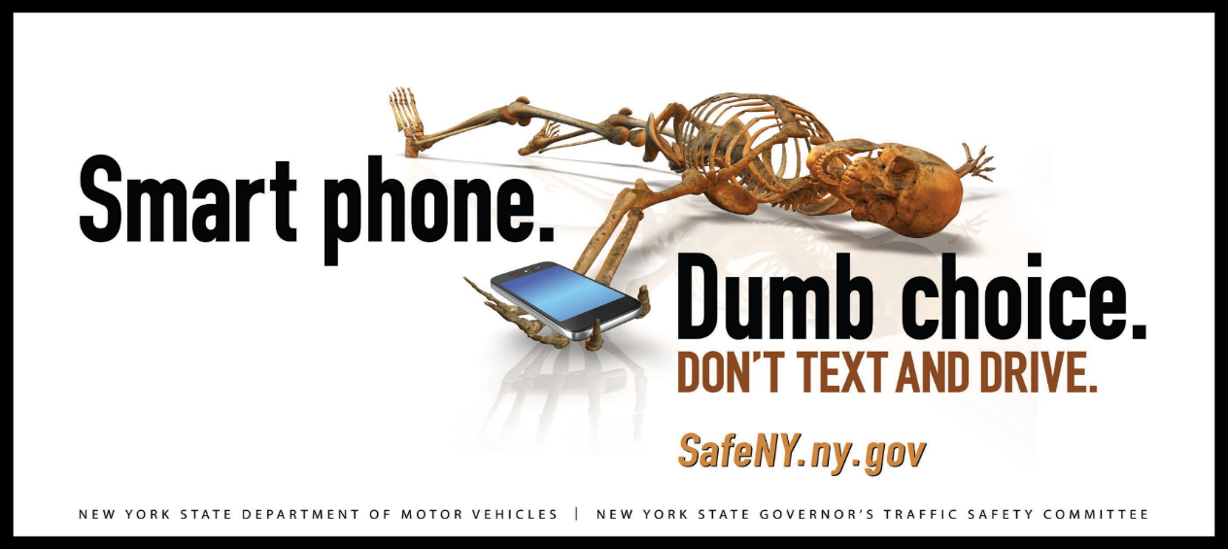
Curbing the trend
Ford Driving Skills for Life
GTSC Teen Driver Summit
No Empty Chair Campaign
Distracted Driving Billboards/PSA’s
“Operation Hang Up” April 10-15, 2014

Slide 22
Changes to Laws
June 1, 2013 - increased to a 5 point violation
On July 1, 2013, the following changes to the cell phone/texting laws for drivers with a probationary license, Class DJ, Class MJ or a learner permit took effect:
Conviction will result in a mandatory 60-day driver license or permit suspension.
Second conviction within six months will result in:
a revocation of at least 6 months of a probationary license, or
a revocation of at least 60 days for a Class DJ or MJ driver license.

Slide 23
Penalties
On July 26, 2013 Governor Cuomo announced new minimum fines and higher maximum fines for distracted driving offenses:
For a first offense, the minimum fine is $50 and maximum fine increases to $150.
For a second offense committed within 18 months, the minimum fine is $50 and the maximum fine increases to $200.
For a third or subsequent offense committed within 18 months, the minimum fine is $50 and the maximum fine increases to $400.

Slide 24
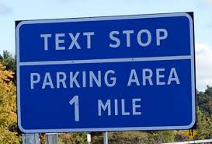
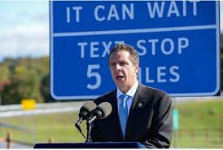
“Texting Zones” September 2013
298 signs notifying motorists
91 texting locations on major highways

Slide 25
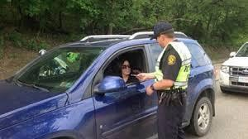
November 1, 2014
Driver’s under age 21 convicted of cell phone/texting while driving will have their license suspended for 120 days for the first offense
Second offense – revocation of one year

Slide 26
Enforcement
Over 200 Police Traffic Service (PTS) grants awarded to local and county police annually ~$2.6 million). These grants allow for DD enforcement OT details.
DD grant to NYSP for $415,000 to conduct DD OT details

Slide 27
Thank You!
Chuck.DeWeese@dmv.ny.gov
518-474-0972

